Slide 1
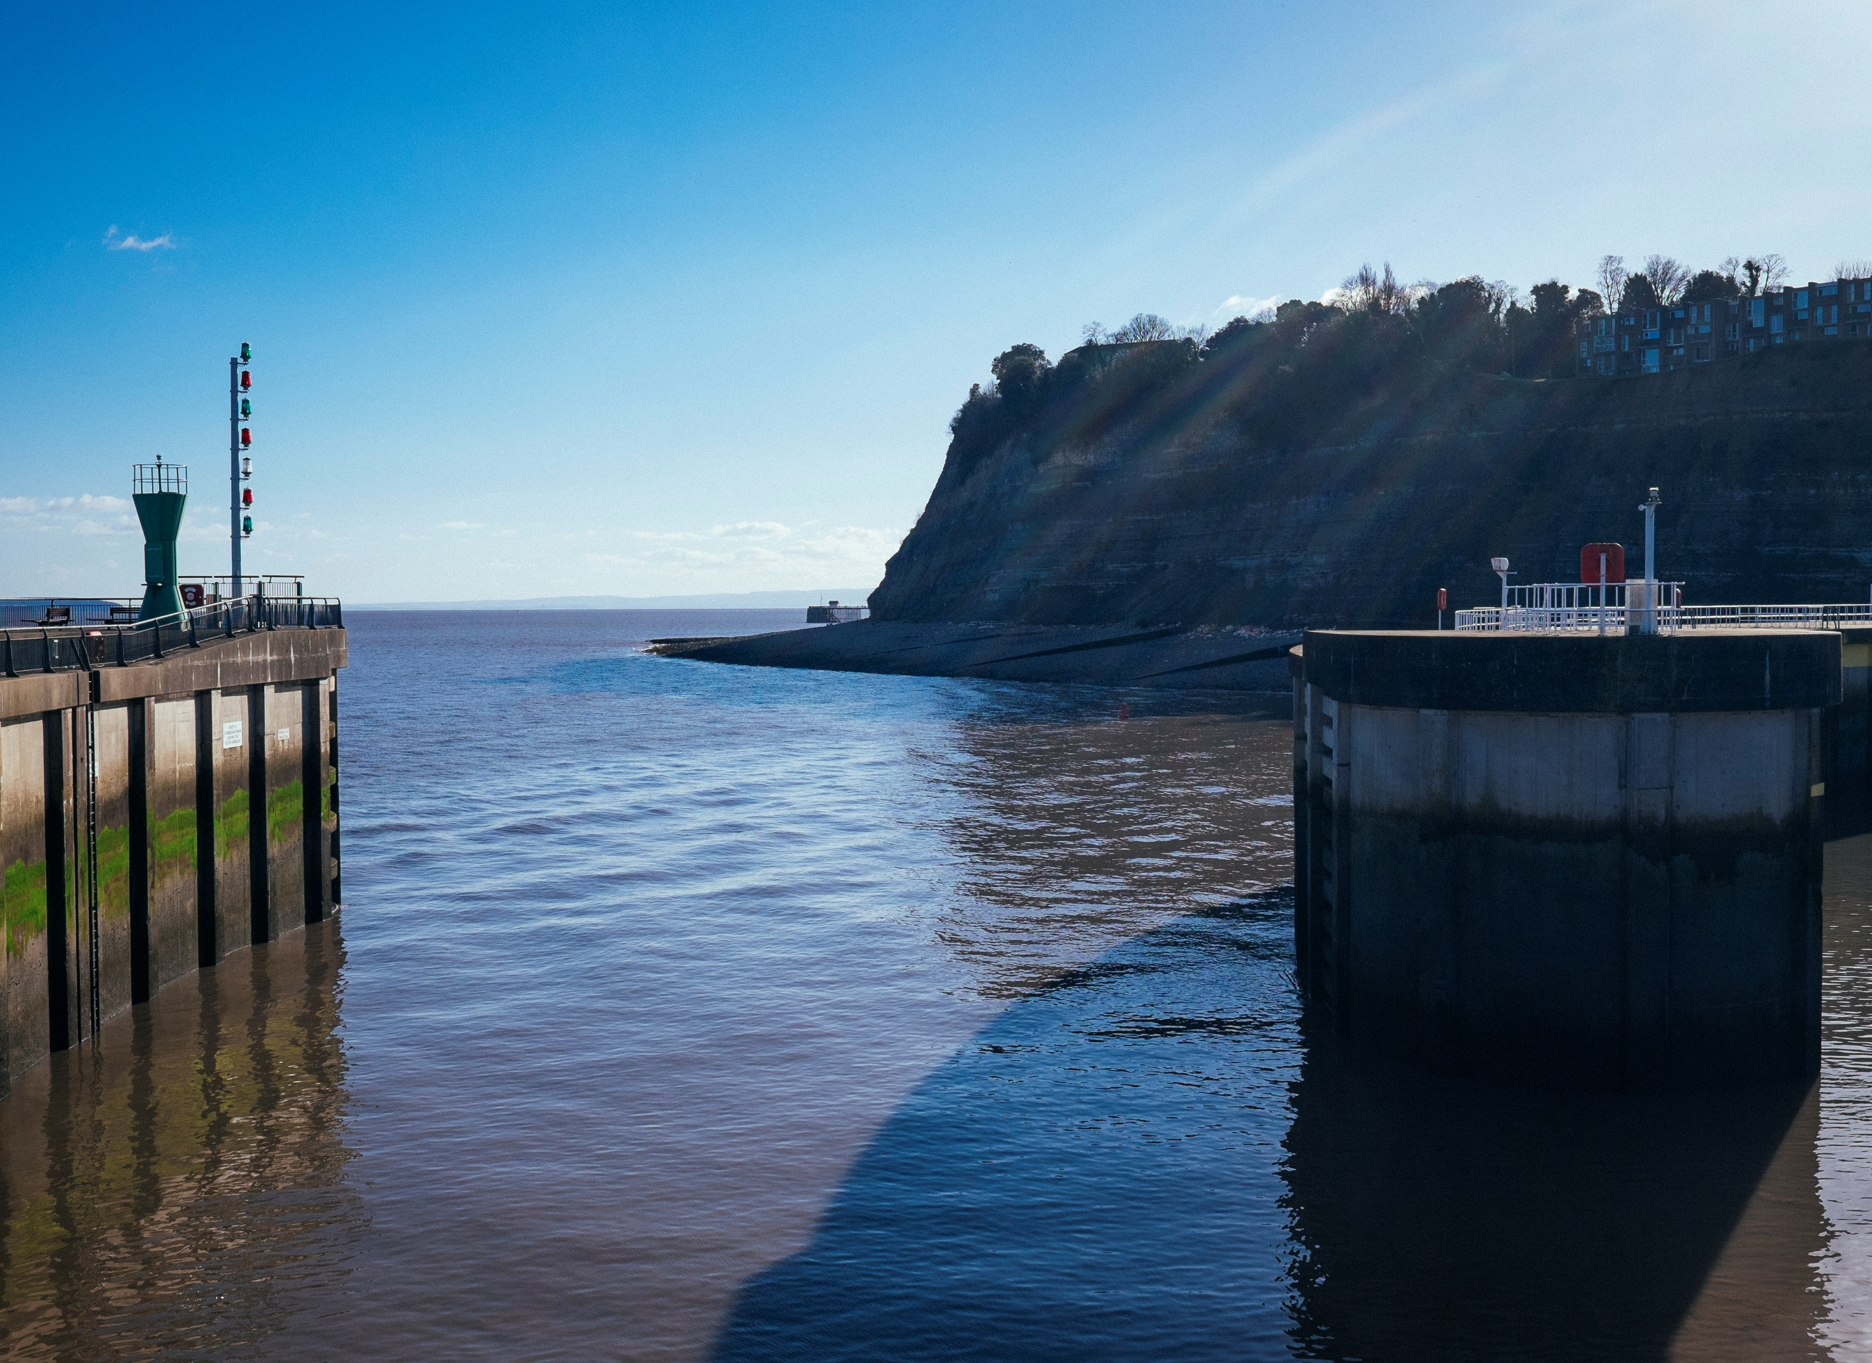




Eco-Sgolion
Defnyddio Data’r Rhwydwaith Ymchwil Iechyd Mewn Ysgolion (SHRN) i Gefnogi Monitro Eco-Sgolion

Slide 2
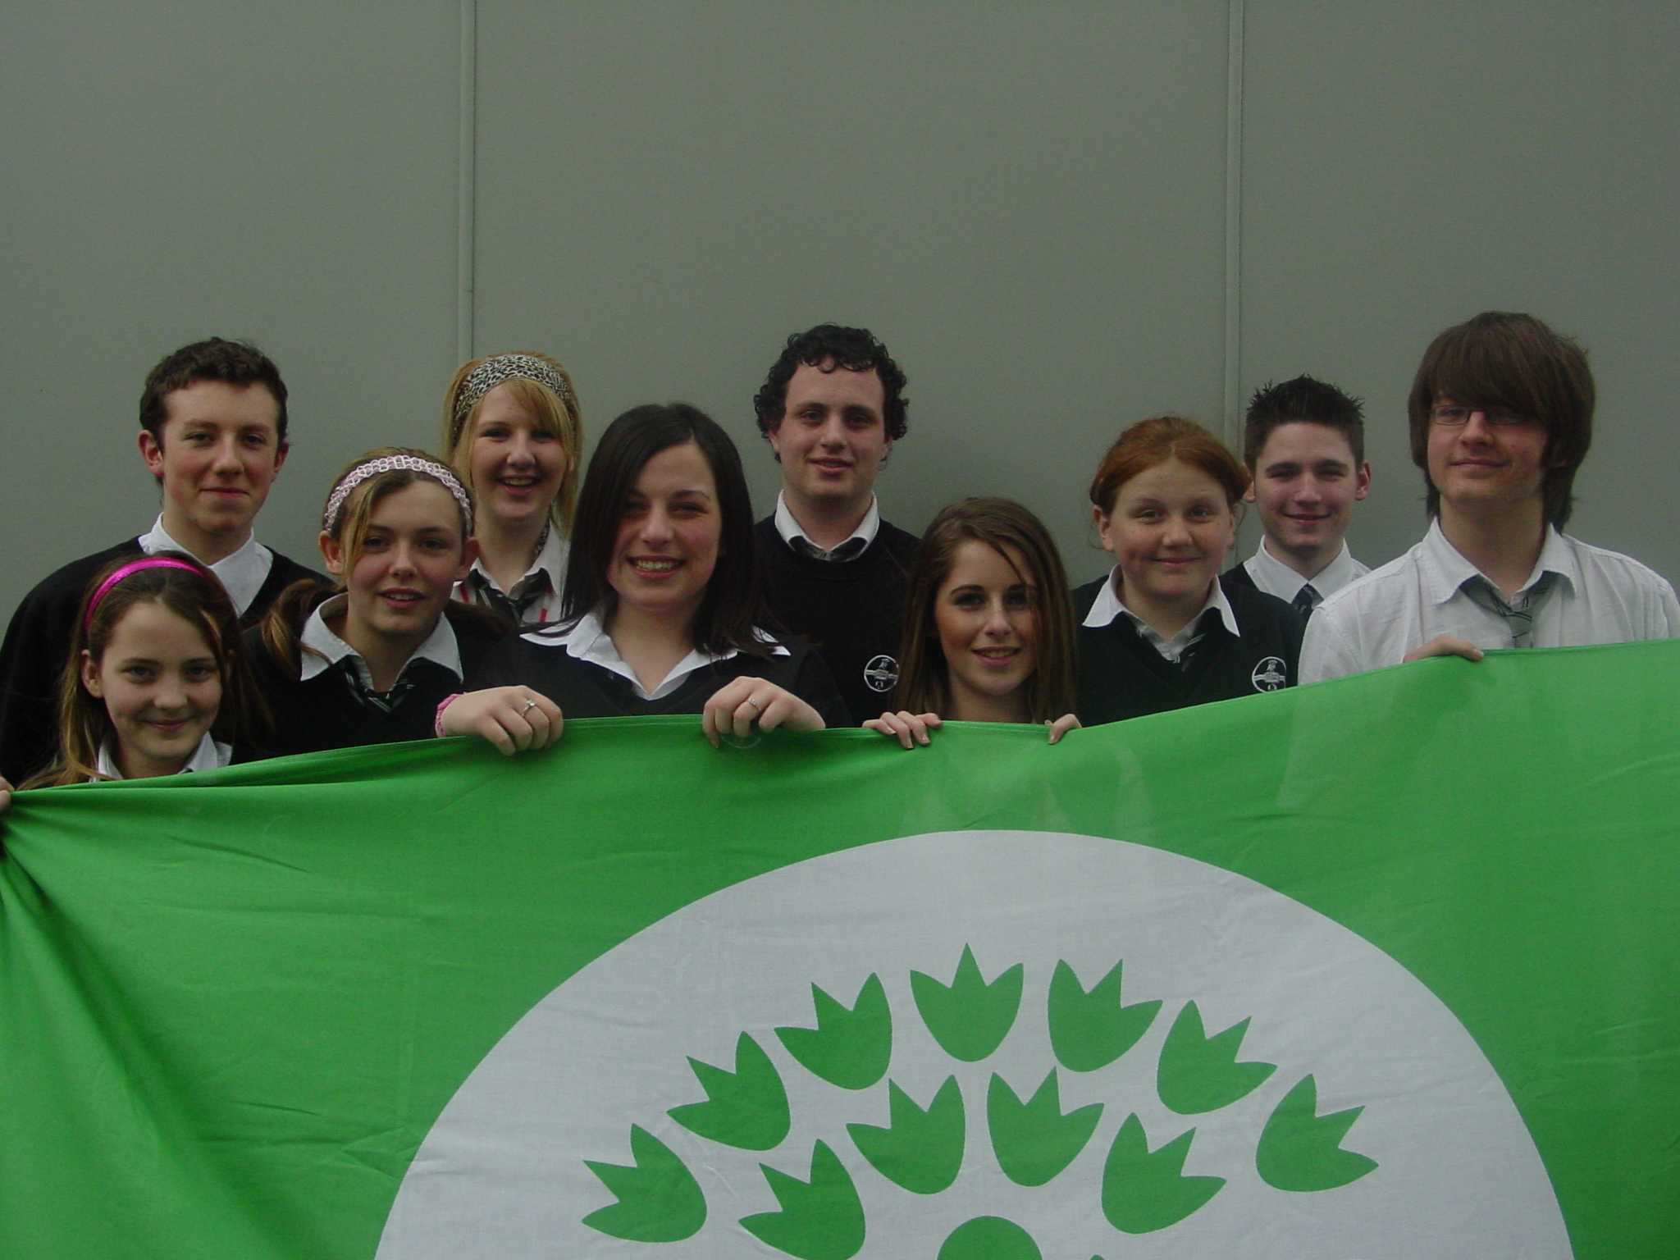
Nodau
Esiampl o ddefnyddio data’r Rhwydwaith Ymchwil Iechyd Mewn Ysgolion i gefnogi gwaith Eco-Sgolion

Slide 3
Beth yw’r Rhwydwaith Ymchwil Iechyd Mewn Ysgolion ?
Am y Rhwydwaith Iechyd Mewn Ysgolion (shrn.org.uk)
“Mae’r Rhwydwaith Iechyd Mewn Ysgolion (SHRN) yn dod ag ysgolion uwchradd, ymchwilwyr acadeimaidd, llunwyr polisi ac ymarferwyr o iechyd, addysg a gofal cymdeithasol at ei gilydd i wella iechyd a lles pobl ifanc yn yr ysgol. Mae’n bartneriaeth rhwng Llywodraeth Cymru, Iechyd Cyhoeddus Cymru, Cancer Research Uk, a Sefydliad Ymchwil, Data a Dulliau Cymdeithasol ac Economaidd. Mae’n cael ei arwain gan y Ganolfan Datblygu a Gwerthuso Ymyriadau Cymhleth ar gyfer Gwella Iechyd y Cyhoedd (DECIPHer) ym Mhrifysgol Caerdydd.”
Notes:
About The School Health Research Network (shrn.org.uk)

Slide 4
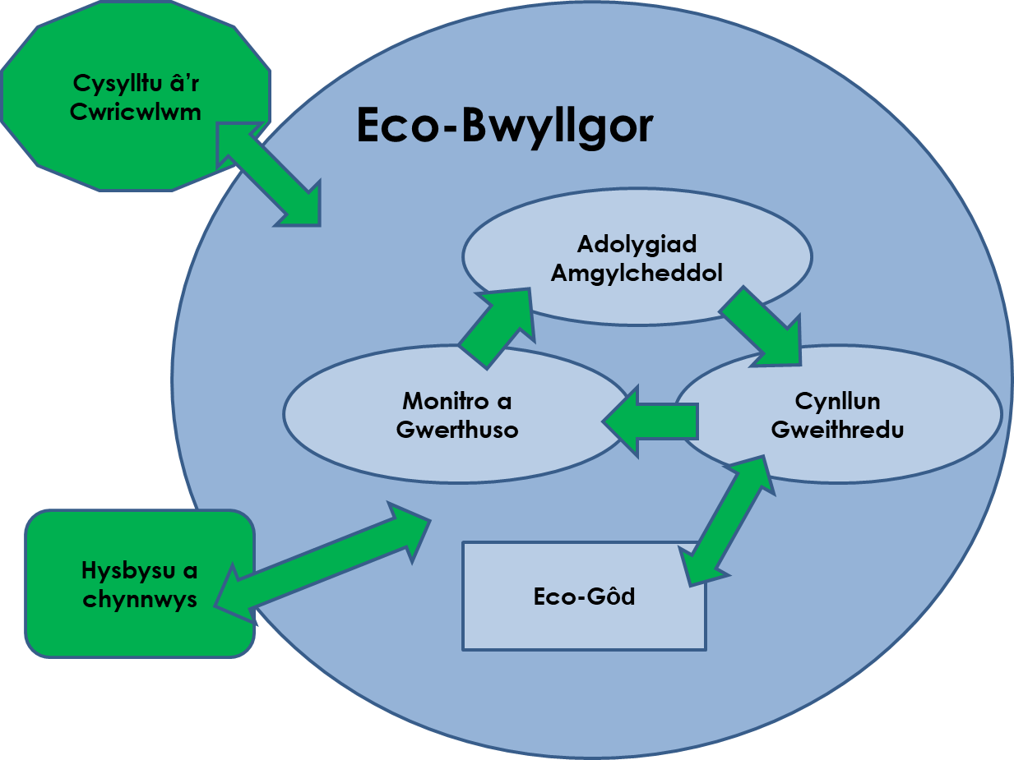
Y Broses Eco-Sgolion

Slide 5

Monitro Mesur Llwyddiant a Gwerthuso
Nid hyn yw monitro: ‘A yw targed y cynllun gweithredu’n cael ei gyflawni?’ Hyn yw monitro: ‘Pa wahaniaeth rydyn ni’n ei wneud wrth weithredu fel hyn?’ Bydd hyn yn ein galluogi i fesur ein cynnydd, i werthuso llwyddiant ein gweithgareddau ac i gynllunio unrhyw newidiadau angenrheidiol.
Notes:
Explanation of monitoring and it’s importance...... This will lead a few slides along to completing an action plan and how they will monitor.....

Slide 6
Teimlad o falchder …
Doo.vote/hyff1
Ar ddiwedd y flwyddyn Ysgol pa un o’r rhain sy’n gwneud i chi deimlo mwyaf balch?
A: Rydym wedi sefydlu stondin gwisg Ysgol ail-law.
C: Rydym wedi sefydlu stondin gwisg Ysgol ail-law ac wedi ailgartrefu 100 o eitemau. Byddai hyn wedi arbed gwerth pwll nofio o ddŵr rhag cael ei ddefnyddio (trwy gynhyrchu eitemau newydd).
B: Rydym ni wedi sefydlu stondin gwisg Ysgol ail-law ac wedi ailgartefu 100 o eitemau.

Slide 7
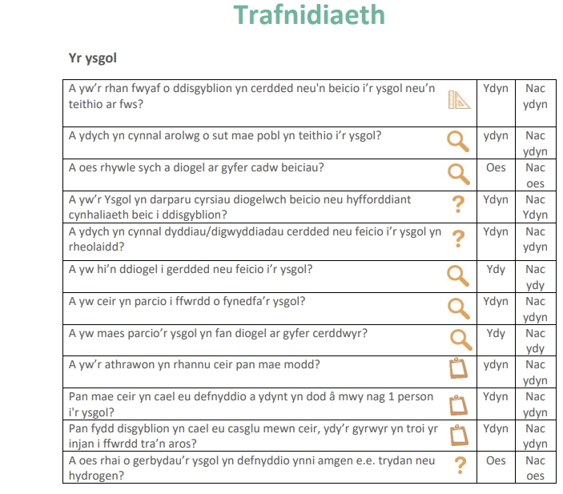
Cysylltu â’r SHRN
Ar ôl cwblhau eich Adolygiad Amgylcheddol bydd gennych rywfaint o ddata ar drafnidiaeth a theithio llesol
Notes:
If your school undertakes the School Health Research Network (SHRN) questionnaire you could also use your results from that to feed into your action planning for example active travel data as part of your monitoring of interventions under the transport topic. The following slides take you through and example using the mock report provided on the SHRN website for fictional school The Sheppard Academy the example report can be downloaded from here Benefits for schools - School Health Research Network (shrn.org.uk)
Your report can also be used as a discussion point with staff and students about possible areas to cover.

Slide 8
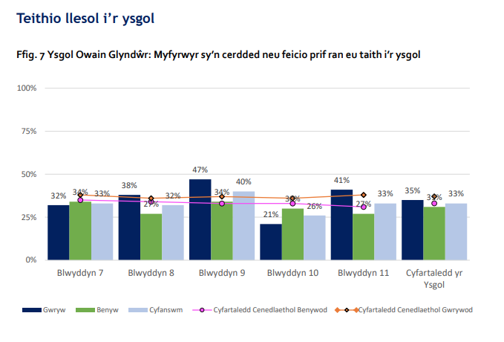
Cysylltu â’r SHRN
Bydd eich adroddiad SHRN yn rhoi gwybodaeth i chi am y dadansoddiad o grwpiau blwyddyn gwrywaidd a benywaidd
Notes:
Where could you target your intervention?
Which year groups would benefit from being explicitly involved in active travel actions?
Linking the pieces of data from the environmental review and the SHRN report gives you a really baseline actions.
You can then carry out your actions and compare the data remembering that year groups will have moved 2 years e.g. yr 8 will become yr 10

Slide 9
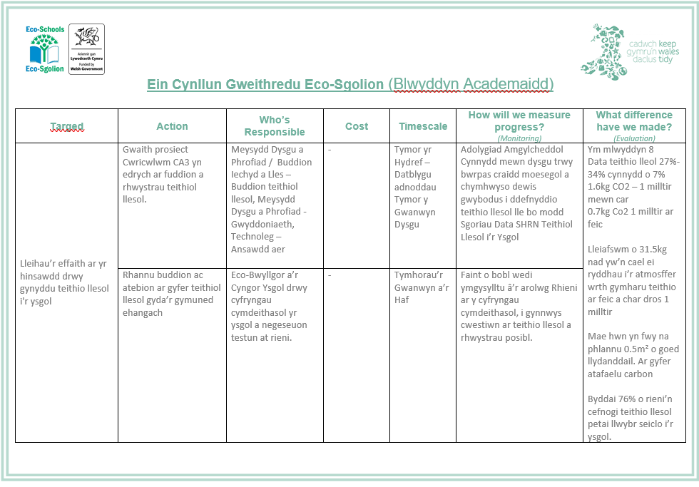
Cysylltu â SHRN
Notes:
How could this look on an action plan?
Maths for impact Data taken from How Bad are Banana's Mike Berners-Lee
1.6kg CO₂e 1 mile in a car (Co2e Carbon dioxide equivalent of gases released during this activity)
0.7kg CO₂e 1 mile bike (cereal breakfast average – changes depending on diet of cyclist)
7%is approximately 35 students when using data in the SHRN report of 218 as total year 8 responses
1.6 – 0.7 = 0.9kg
0.9x35 = 31.5kg CO₂e not released
100m2 of replanted broadleaf forest in the UK 5 tonnes of CO₂e removed
1 tonne = 1016kg
5 = 5080kg
5080/100 = 50.8kg for 1 m²
50.8/2 = 25.4kg for 0.5m² of broadleaf replanting.

Slide 10
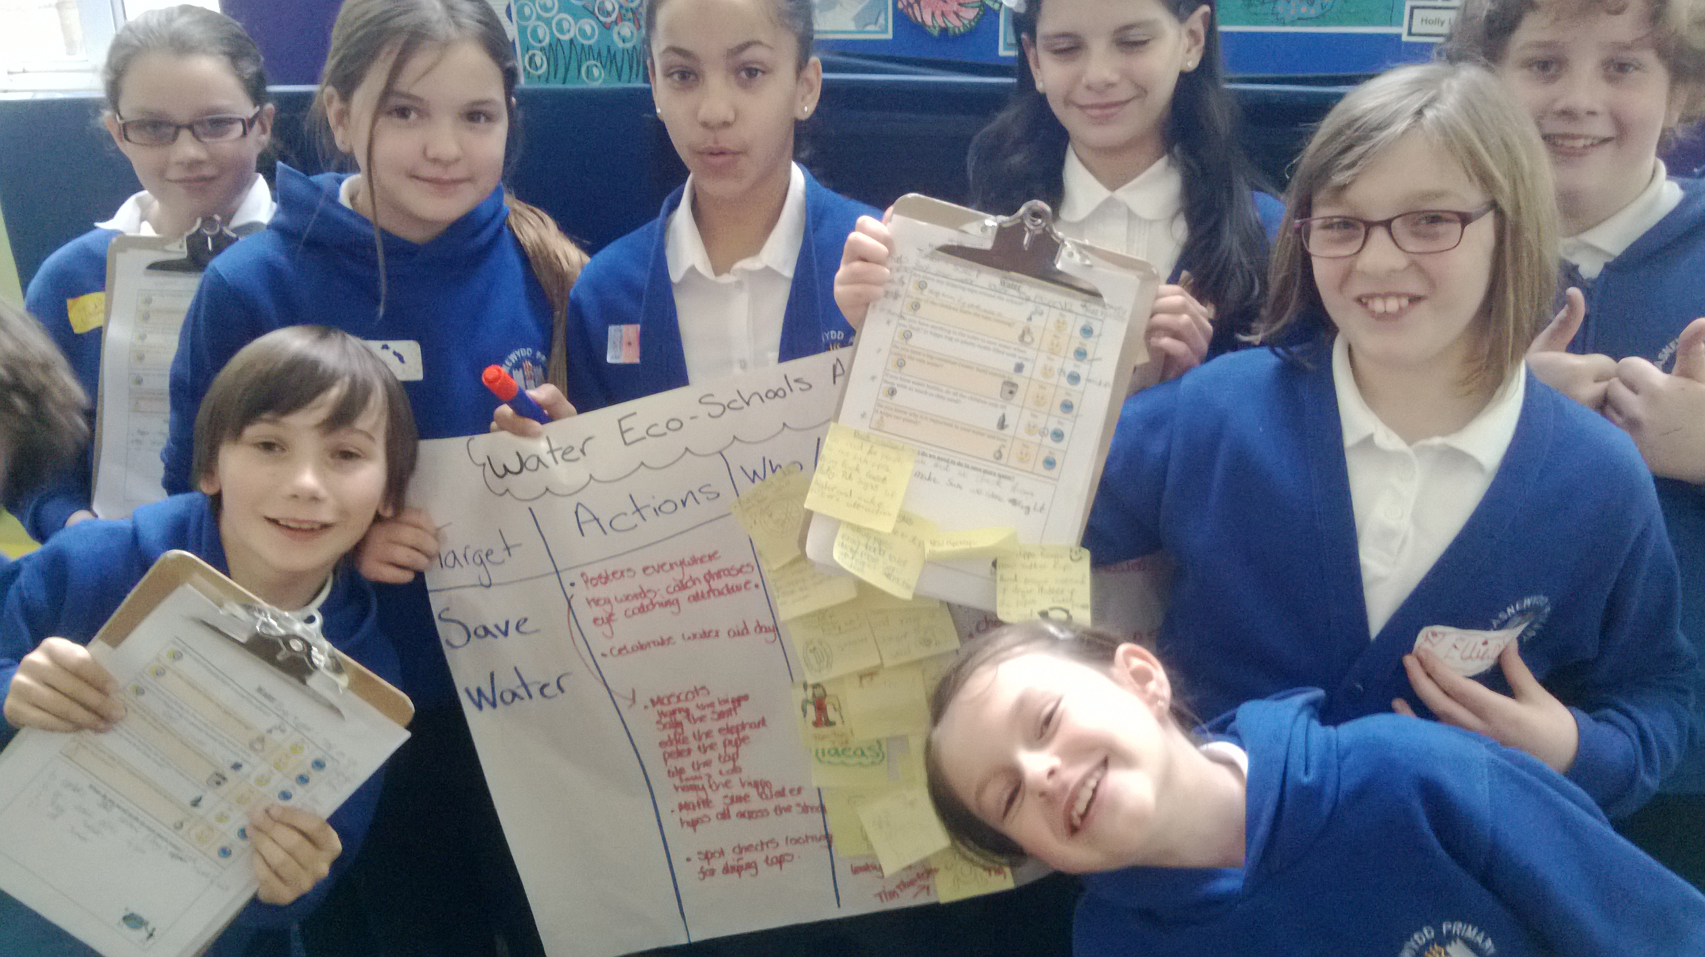
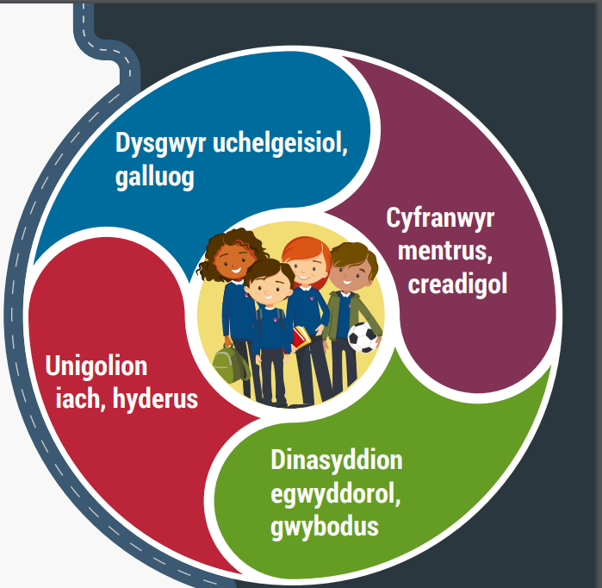
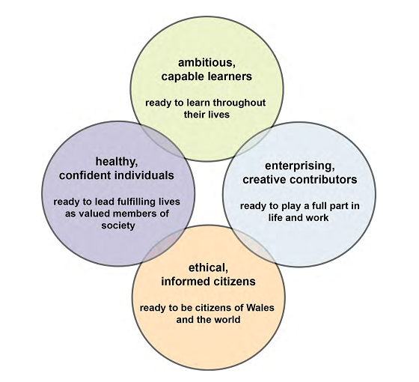
Y disgyblion yn arwain yr addysgu a’r camau amgylcheddol
Notes:
. New curriculum offers much more flexibility and compliments the pupil-driven approach that Eco-Schools embodies.

Slide 11
Targedau Wedi’u Gyrru gan Waith Dosbarth
Disgyblion yn dysgu am fater amgylcheddol mewn gwaith dosbarth/pwnc
Disgyblion yn teimlo’n angerddol ac eisiau defnyddio’r hyn maen nhw wedi’i dysgu i weithredu
Ychwanegu syniadau at gynllun geithredu’r dosbarth a’u rhannu gyda’r Eco-Bwyllgor a’r ysgol gyfan
Gweithredau’n digwydd trwy waith dosbarth/ trwy waith y pwyllgor
Mae’r dosbarth yn darganfod sut i fesur y newid ac yn rhannu hyn gyda’r gymuned gyfan (a’r byd ehangach)
Notes:
This method is much more in line with the Donaldson Principles and embraces the pupil led learning element and then builds on it. It is important that once children have learnt about a subject and found something that they feel passionate or concerned about, that there is an avenue for them to take action to improve the situation. This model takes this concept and links it into the Eco-Schools approach.

Slide 12




33-35 Heol yr Eglwys Gadeiriol, Caerdydd, CF11 9HB | 33-35 Cathedral Rd, Cardiff, CF11 9HB
029 2025 6767 keepwalestidy.cymru info@keepwalestidy.cymru
Cadwch Gymru’n Daclus yn gwmni wedi ei gyfyngu trwy warant. Rhif Cwmni: 4011164 Rhif Elusen: 1082058 Rhif TAW: 850 3958 13
Keep Wales Tidy is a Company Limited by Guarantee. Company Registration Number: 4011164 Charity Registration Number: 1082058 VAT Registration Number: 850 3958 13

