Slide 1





Eco-Schools
Using School Health Research Network (SHRN) Data to Support Eco-Schools Monitoring

Slide 2

Aims
Example of using SHRN data to support Eco-Schools work

Slide 3
What is SHRN?
About The School Health Research Network (shrn.org.uk)
“The School Health Research Network (SHRN) brings together secondary schools and academic researchers, policy-makers and practitioners from health, education and social care to improve young people’s health and wellbeing in the school setting. It is a partnership between Welsh Government, Public Health Wales (PHW), Cancer Research UK and the Wales Institute of Social and Economic Research, Data and Methods. It is led by the Centre for the Development and Evaluation of Complex Interventions for Public Health Improvement (DECIPHer) at Cardiff University.”
Notes:
About The School Health Research Network (shrn.org.uk)

Slide 4
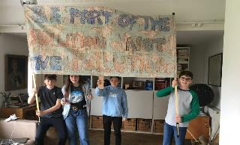
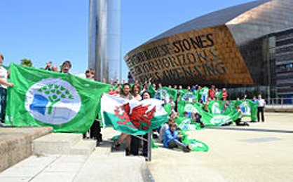
Why Being an Eco-School is Important
Empowers young people (and staff) to make a positive environmental impact
Facilitates change makers who leave school knowing that their voices can and do make a difference
Develops skills including leadership and critical thinking
Empowers our students (and staff) to take action on climate change
Authenic links to the New Curriculum for Wales
Builds on key skills thus supporting the LNF and DCF and encompassing ESDGC
Compliments the Estyn Inspection Framework
Can lead to financial savings
Notes:
Benefits to pupils and pupil voice quotes etc
Wider links
Links to
Global Goals
Rights respecting school
Healthy School Scheme
Investors in Families
Connecting Classrooms
Fair Trade school
Connectedness to nature

Slide 5
Eco-Schools Process
Linking to the Curriculum
Eco-Committee
Environmental
Review
Monitoring and Evaluation
Action Plan
Informing and Involving
Eco-Code
Notes:
7 step process which allows for authentic student voice and action, through the Eco-Committee and wider school work.
A component of the process is monitoring and evaluating the work and actions carried out – how can this be achieved?

Slide 6

Monitoring Measuring Success and Evaluation
Monitoring is not: ‘Is the action plan target being done?’ Monitoring is: ‘What difference are we making by carrying out this action?’ This will enable us to measure our progress, evaluate the success of our activities and plan any necessary changes
Notes:
Explanation of monitoring and it’s importance......
Emphasise: What difference are we making what impact are we having?

Slide 7
A feeling of Pride…..
At the end of the school year, which of the following makes you feel the most proud?
A: We set up a second hand uniform stall.
C: We set up a second hand uniform stall and rehomed 100 items of clothing. This would have saved a whole swimming pool worth of water from being used to produce new clothes!
B: We set up a second hand uniform stall and rehomed 100 items of clothing

Slide 8
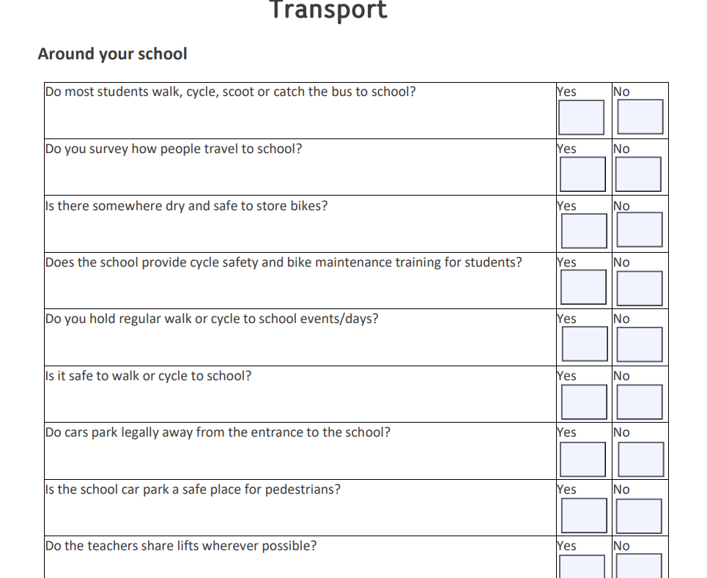
Linking to SHRN
After completing your Environmental Review you have some data on transport and active travel
Notes:
If your school undertakes the School Health Research Network (SHRN) questionnaire you could also use your results from that to feed into your action planning for example active travel data as part of your monitoring of interventions under the transport topic. The following slides take you through and example using the mock report provided on the SHRN website for fictional school The Sheppard Academy the example report can be downloaded from here Benefits for schools - School Health Research Network (shrn.org.uk)
Your report can also be used as a discussion point with staff and students about possible areas to cover.

Slide 9
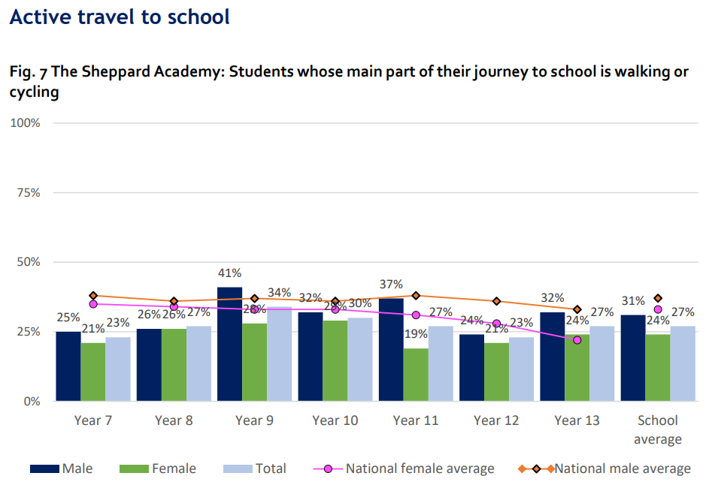
Linking to SHRN
Your SHRN report will give you information about the break down of year groups male and Female
Notes:
Where could you target your intervention?
Which year groups would benefit from being explicitly involved in active travel actions?
Linking the pieces of data from the environmental review and the SHRN report gives you a really baseline actions.
You can then carry out your actions and compare the data remembering that year groups will have moved 2 years e.g. yr 8 will become yr 10

Slide 10
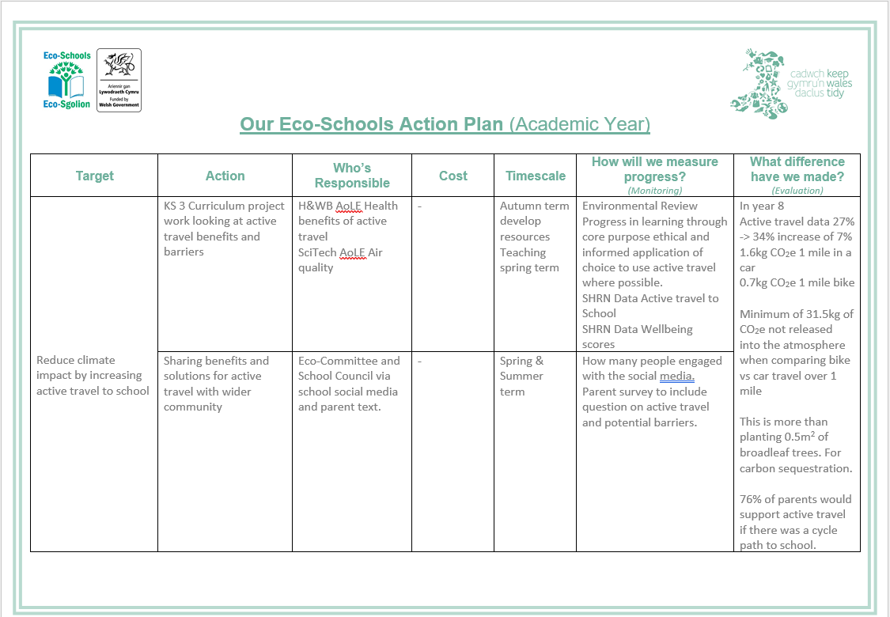
Linking to SHRN
Notes:
How could this look on an action plan?
Maths for impact Data taken from How Bad are Banana's Mike Berners-Lee
1.6kg CO₂e 1 mile in a car (Co2e Carbon dioxide equivalent of gases released during this activity)
0.7kg CO₂e 1 mile bike (cereal breakfast average – changes depending on diet of cyclist)
7%is approximately 35 students when using data in the SHRN report of 218 as total year 8 responses
1.6 – 0.7 = 0.9kg
0.9x35 = 31.5kg CO₂e not released
100m2 of replanted broadleaf forest in the UK 5 tonnes of CO₂e removed
1 tonne = 1016kg
5 = 5080kg
5080/100 = 50.8kg for 1 m²
50.8/2 = 25.4kg for 0.5m² of broadleaf replanting.

Slide 11
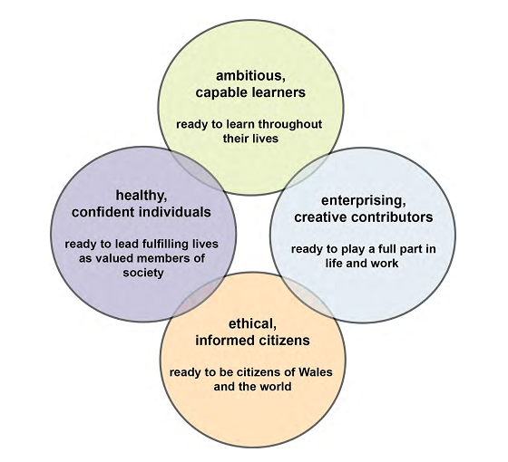
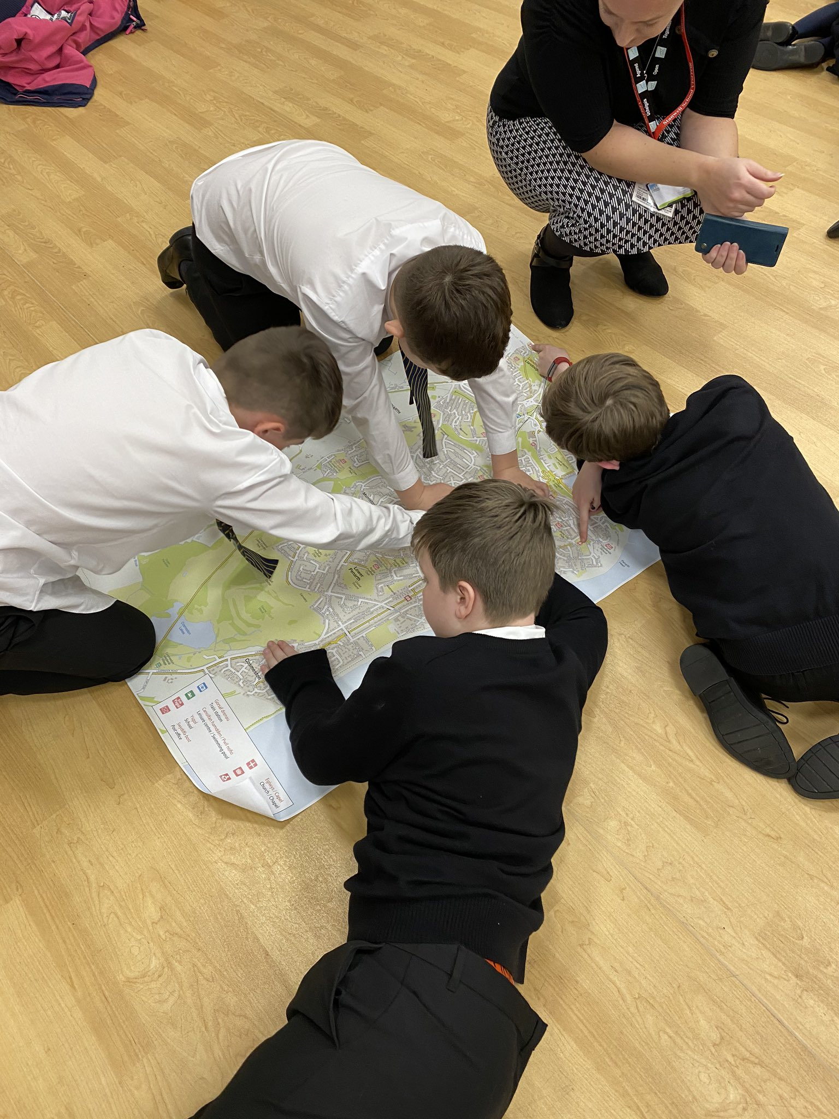
A pupil driven approach to learning and taking environmental action
Notes:
A crucial element of the Eco-Schools programme is, where possible, linking its 9 topics to the curriculum. Learning about different environmental issues and, not only the causes/effects but also what can be done to help/stop these problems is essential to enabling young people to identify necessary actions and also prevent eco-anxiety.
The New curriculum offers much more flexibility and compliments the pupil-driven approach that Eco-Schools embodies. Eco-schools compliments the 4 core purposes.

Slide 12
Classwork driven targets
Pupils learn about environmental issue in class/topic work
Pupils feel passionate and want to use what they’ve learnt to take action
Add ideas to class-led action plan and share with Eco-Committee and whole school.
Action undertaken by class, Eco-Committee, wider school
Class works out how to measure the change and share with the whole community and wider world!
Notes:
This method is much more in line with the New Curriculum and embraces the pupil led learning element and then builds on it.
It is important that once students have learnt about a subject and found something that they feel passionate or concerned about, that there is an avenue for them to take action to improve the situation. This model takes this concept and links it into the Eco-Schools approach.
Important for students to feel empowered to make change when learning about this topic areas to help mitigate against the feeling of being powerless which can lead to a feeling of Eco-Anxiety Climate change: Are you suffering from ‘eco-anxiety’? - BBC Three

Slide 13





Further Support
Secondary Specialists
Fran.Watkin@keepwalestidy.cymru
Aimee.Hallett@keepwalestidy.cymru
Social Media
Home - Keep Wales Tidy
@EcoSchoolsWales
@Keep_Wales_Tidy
Eco-Schools Wales
Eco-Schools Wales
Notes:
Please get in touch if you or your colleagues need any further support to embed Eco-Schools within your school.

Slide 14




33-35 Heol yr Eglwys Gadeiriol, Caerdydd, CF11 9HB | 33-35 Cathedral Rd, Cardiff, CF11 9HB
029 2025 6767 keepwalestidy.cymru info@keepwalestidy.cymru
Cadwch Gymru’n Daclus yn gwmni wedi ei gyfyngu trwy warant. Rhif Cwmni: 4011164 Rhif Elusen: 1082058 Rhif TAW: 850 3958 13
Keep Wales Tidy is a Company Limited by Guarantee. Company Registration Number: 4011164 Charity Registration Number: 1082058 VAT Registration Number: 850 3958 13

