Slide 1
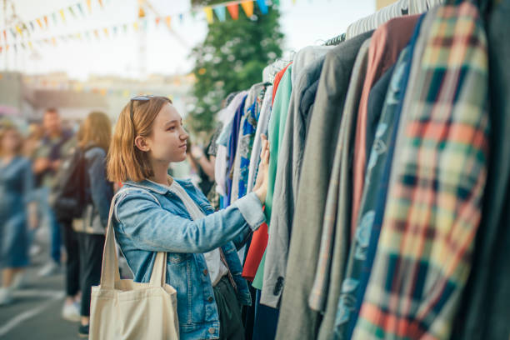



Circular Fashion

Slide 2

Notes:
https://youtu.be/3iKHr-JnWYA

Slide 3
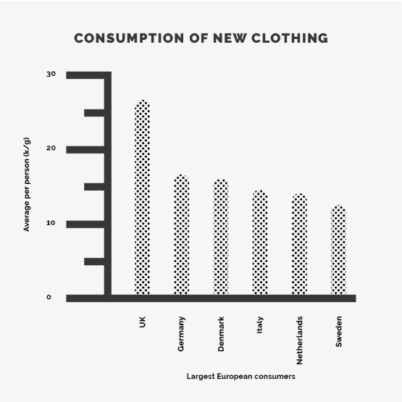
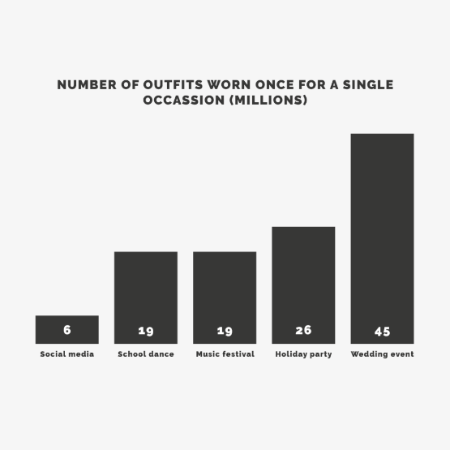
Notes:
Images from Eco Wardrobe - https://ecowardrobe.co.uk/sustainability/

Slide 4
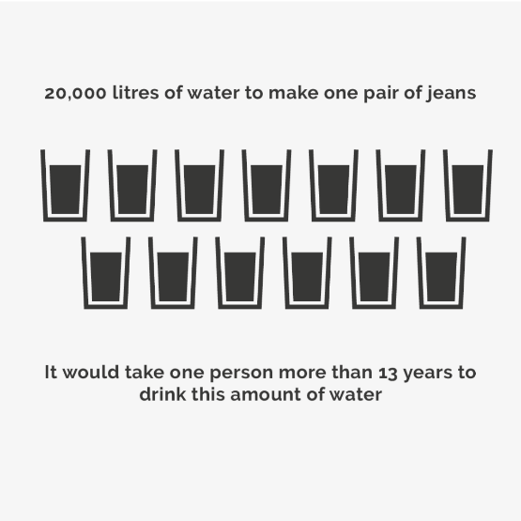
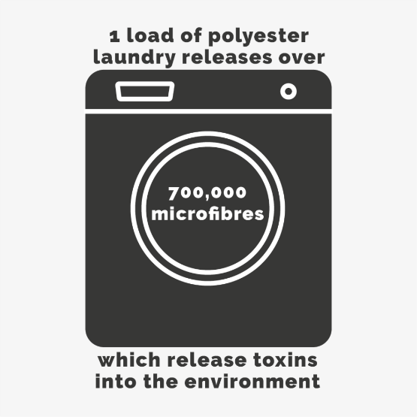
Notes:
Images from Eco Wardrobe - https://ecowardrobe.co.uk/sustainability/

Slide 5
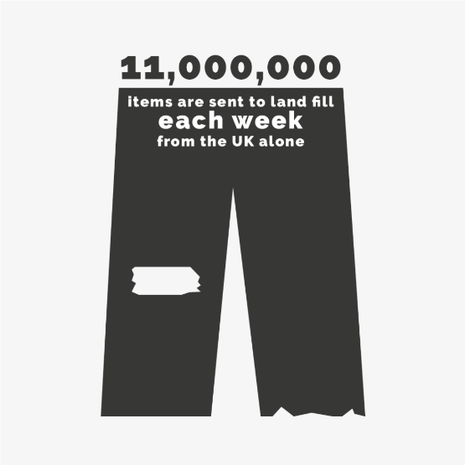
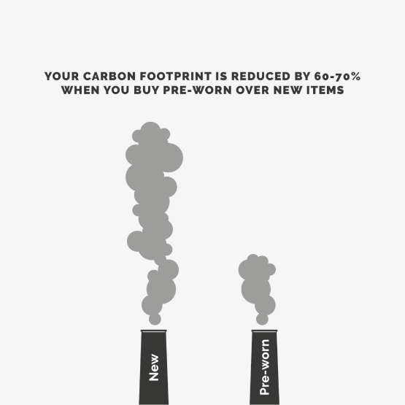
Notes:
Images from Eco Wardrobe - https://ecowardrobe.co.uk/sustainability/

Slide 6
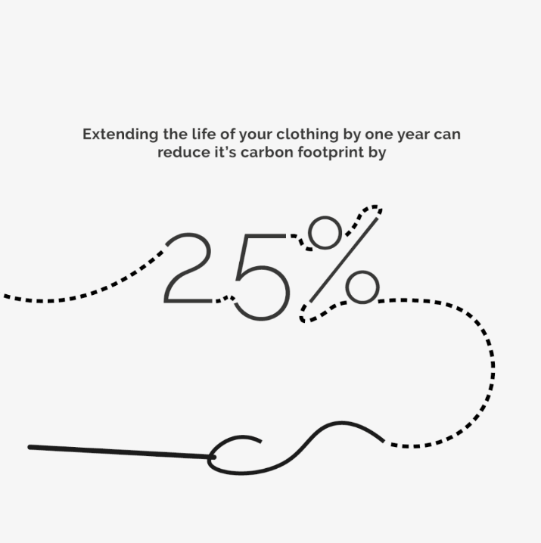
Can you think of any circular fashion brands or organisations?
Notes:
Image from Eco Wardrobe - https://ecowardrobe.co.uk/sustainability/

Slide 7
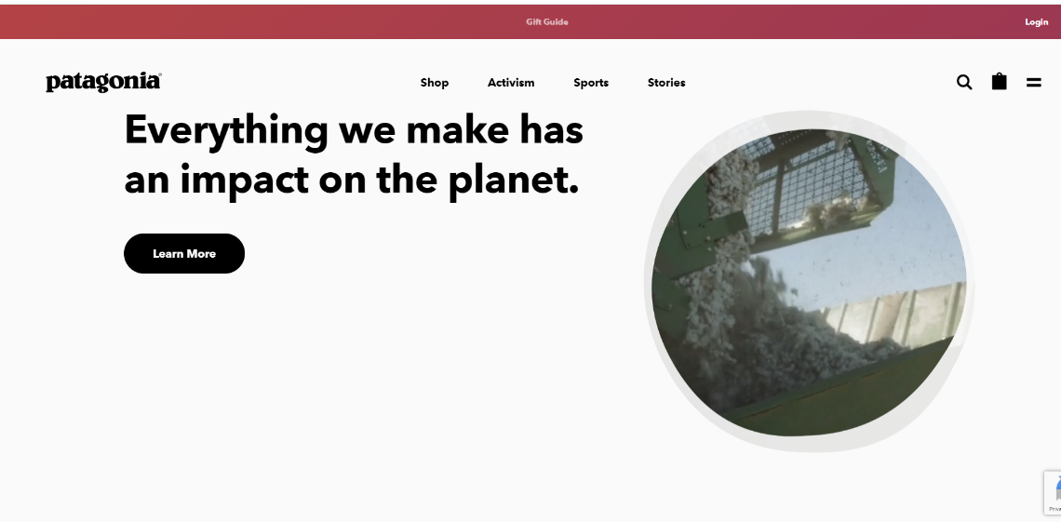

Notes:
https://eu.patagonia.com/gb/en/home/
Patagonia is an American outdoor clothing company.
It guarantees everything it makes and offers free life-time returns or repairs. They have their own repair hub called Worm Wear.
It ensures all its products are sustainably and ethically produced. On its website you will find comprehensive information about how and where its materials are sourced and its products and made and transported. It all explains its carbon footprint in great detail. They are not perfect but they explain everything they do and why and every thing they are try to do to make things better.
It donates 1% off all profits made to the 1% for the planet fund. They have also given money to well on 1000 environmental causes.

Slide 8
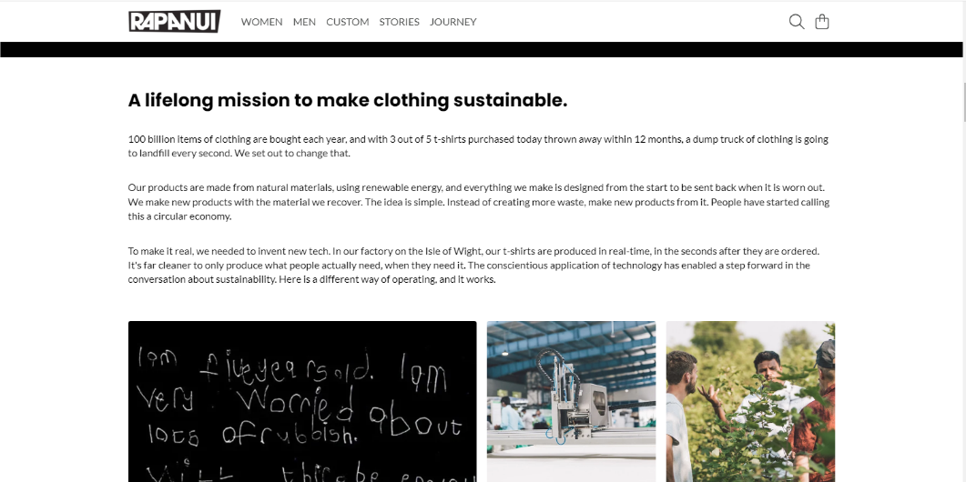

Notes:
https://rapanuiclothing.com/
Rapanui are based in Isle of Wight and all of their clothing is made from organic materials using renewable energy.
One of their main lines are custom made t-shirts. They print these in real time meaning no waste as everything is made to order.
Everything they make is designed from the start to be sent back when it is worn out and they make new products with the material they recover by mixing it with new organic materials. These ‘remilled’ items can be sent back again and again. Circular. Its also free to send your items back, and you get a voucher off you next purchase in return.
Plus you can design your own t-shirt with them, custom made!

Slide 9
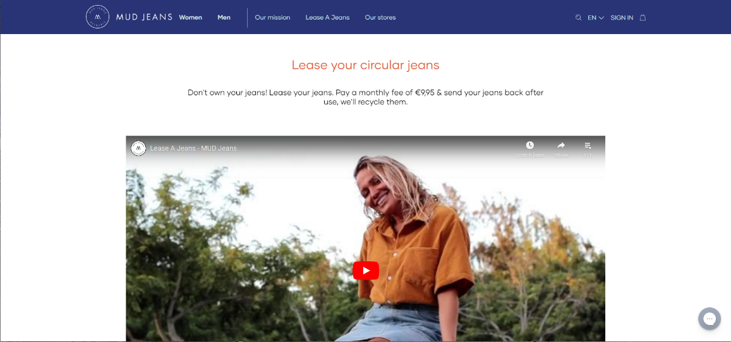

Notes:
https://mudjeans.eu/
Mud’s jeans are made of organic and recycled materials and are toxic free. They ensure fair labour in all their production.
They are the first company in the world to lease (rent) jeans. Meaning you subscribe and choose your jeans – keep and wear them and then send them back when you want a new pair and they are recycled. They also offer packages for the whole family! Free repairs are included too.
There is also lots of information on their website about their material, workers and production processes.

Slide 10
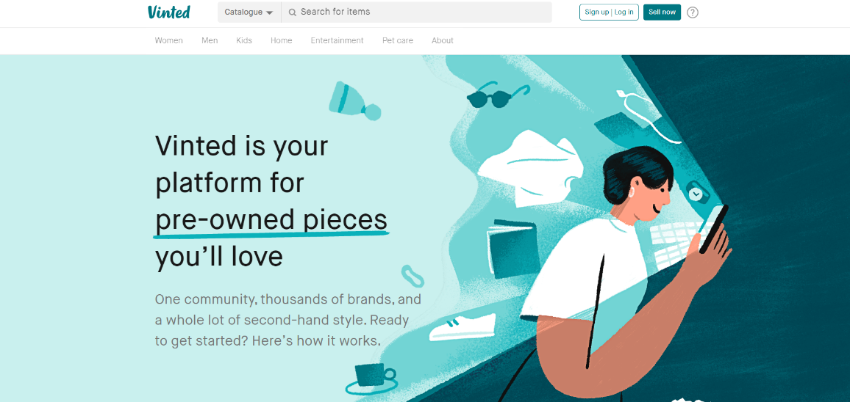

Notes:
https://www.vinted.co.uk/
Vinted is an online/app platform for the general public to buy and sell new and used clothing anywhere in the UK. With so much clothing going to landfill, this makes is more accessible to people to by pre-loved (or unwanted new) at a affordable prices, thus saving it from landfill.

Slide 11
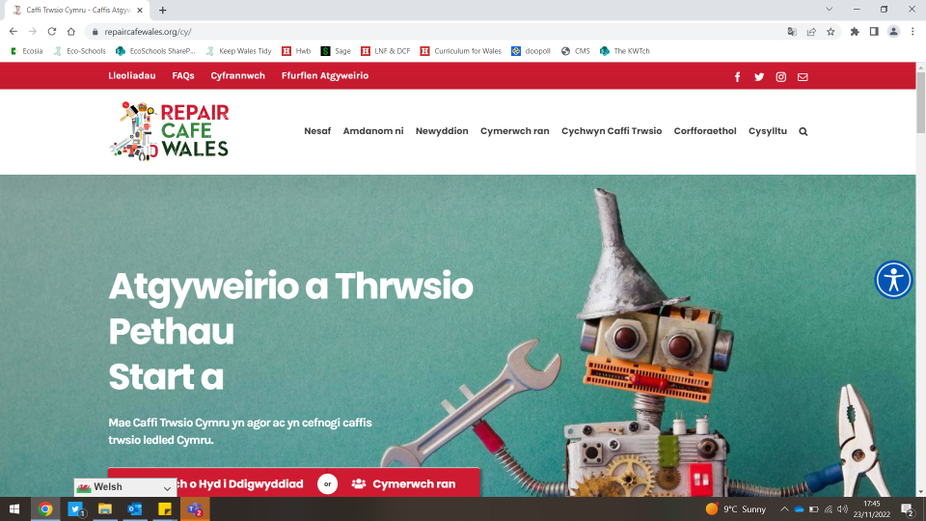

Notes:
Https://repaircafewales.org/
Repair Café Wales are an Organisation with ‘pop up’ places all over Wales which you can take all sorts of items, including clothes, to be repaired for you, for free by volunteers. Again, this saved items from being thrown away and ending up in landfill and, in turn, prevents people from having to buy replacements and more stuff!
Workshop are also held to teach repair skills to others. This could be bikes, electrical items, toys, furniture and of course textiles, clothing and accessories amongst other things.

Slide 12
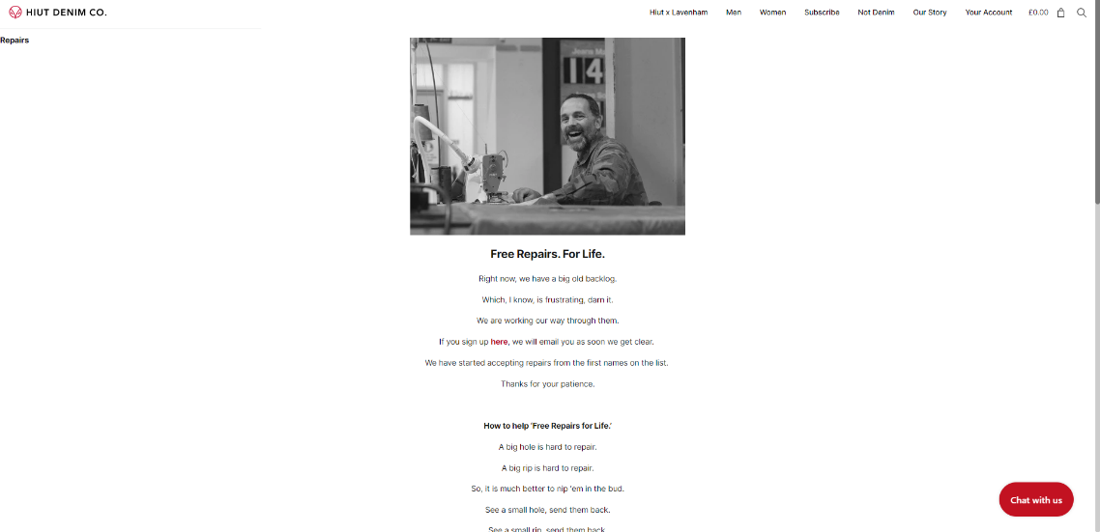

Notes:
https://hiutdenim.co.uk/
Handmade in Wales, Hiut Jeans offer free repairs for life with their jeans. They are very expensive, but and rips or breaks – send them back and they will fix them up and return them to you as good as new.

Slide 13
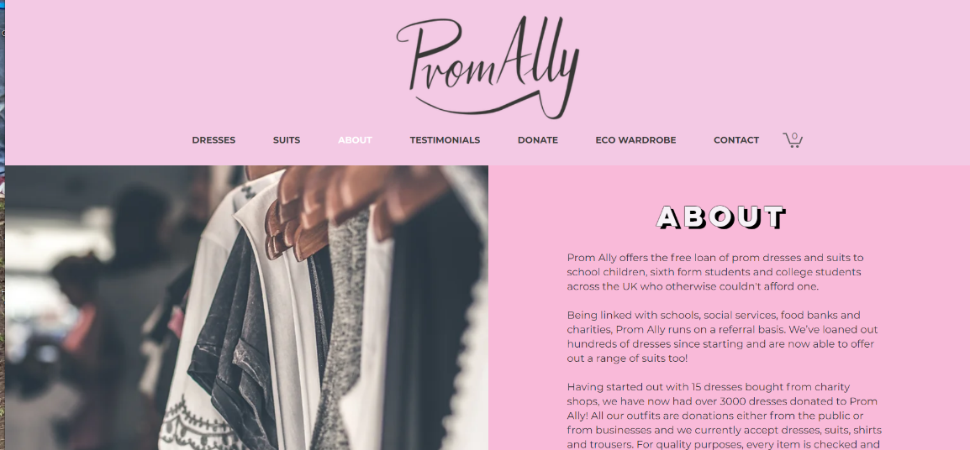

Notes:
https://www.promally.co.uk/
Prom Ally are a Welsh company who loan out prom dresses and suits for free to school children, sixth form students and college students across the UK who otherwise couldn't afford one. They do this free of charge and have loaned out hundreds of dresses since the first began. Again, reusing stps the unwanted clothes from going to landfill and also reduces the need to yet again buying more stuff!

Slide 14
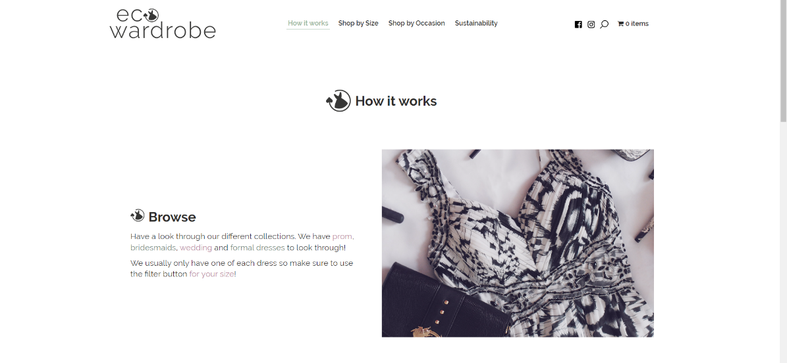

Notes:
https://ecowardrobe.co.uk/
Another arm to Prom Ally is the Eco Wardrobe. This service offers formal dresses and suit hire for a minimal fee. Again designed around the idea of reusing and making clothes circular, this idea save people form buy new and prevents even more (and more) items of clothing form ending up in landfill. A circular process.
All the money made from the eco-wardrobe goes back into the free service offered by Prom Ally.
And they both help the planet.

Slide 15
Now its your turn to re-think fashion…
Carry out further research into existing Circular Fashion. Use what you learn to inspire your design of your own brand selling a circular clothing item or line.
Consider -
Name and story – many sustainable brands have a great story behind them
What is you product and why? How is it being sold/used?
Where is it made, what materials are used?
What makes it sustainable and circular? How can it help the planet?
Packaging, care, end of life choices?
Anything else that is important people know about your brand

Slide 16





33-35 Heol yr Eglwys Gadeiriol, Caerdydd, CF11 9HB | 33-35 Cathedral Rd, Cardiff, CF11 9HB
029 2025 6767 cadwchgymrundaclus.org | keepwalestidy.org comms@keepwalestidy.org
Cadwch Gymru’n Daclus yn gwmni wedi ei gyfyngu trwy warant. Rhif Cwmni: 4011164 Rhif Elusen: 1082058 Rhif TAW: 850 3958 13
Keep Wales Tidy is a Company Limited by Guarantee. Company Registration Number: 4011164 Charity Registration Number: 1082058 VAT Registration Number: 850 3958 13

