Slide 1
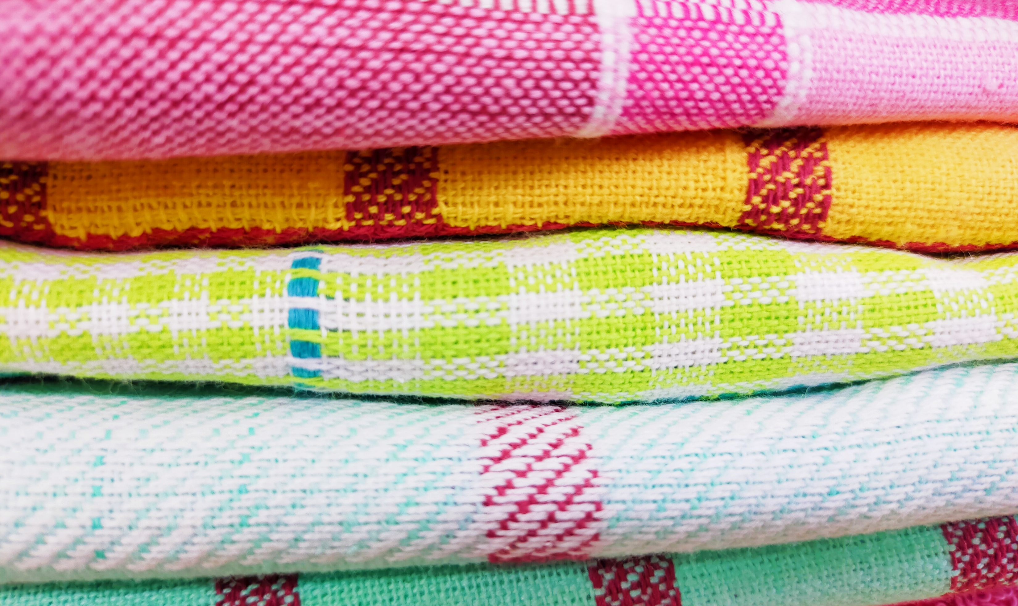

Material Impact

Slide 2
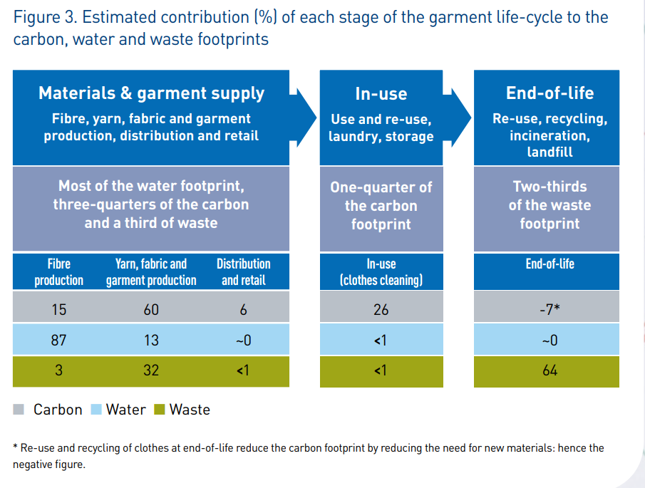
Why are materials important?

Slide 3
Materials T-shirts can be made from
Synthetic Fibres e.g spandex, lycra, viscose and nylon | Recycled Polyester | Merino Wool
Cotton | Polyester | Orange Fibre
Hemp | Bamboo | Organic Cotton
Notes:
Sustainable Fabrics • Guide on the most ethical materials [2020] — SustainYourStyle

Slide 4
Polyester
Average footprint per tonne of fibre in clothing
Carbon 21 tCO₂e
Water 80m³
Waste 1.4t
Uses lots of energy to produce
Does not biodegrade
Releases microplastics when washed or in landfill
Easy to care for lasts a long time
Made from crude oil (fossil fuel)

Slide 5
Synthetic Fibres
Shed microfibres when washed or in landfill
Average footprint per tonne of fibre in clothing
Nylon (polymide)
  Carbon 24tCO2e
  Water 80m3
  Waste 1.4t
Made from petroleum
High energy needed
Non-biodegradable
Harmful chemicals
Average footprint per tonne of fibre in clothing
Viscose
  Carbon 30tCO2e
  Water 3,800m3
  Waste 1.6t

Slide 6
Organic Cotton
Low water (71% less than conventional cotton)
No chemicals such as pesticides used
Traditional farming methods such as crop rotation to protect soil health
Low energy

Slide 7
Orange Fibre
Made from a waste material from the orange juice industry
No soil erosion
Natural fibre so biodegradable
Expensive as only small quantity can be produced
Not widely available

Slide 8
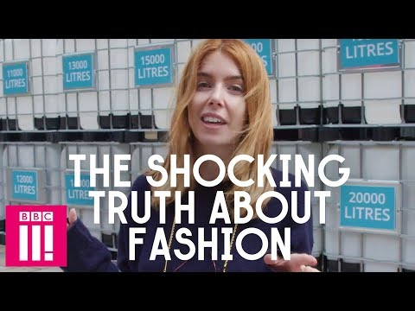
Cotton
Average footprint per tonne of fibre in clothing
Carbon 28 tCO2e
Water 3,100m3
Waste 1.6t
Natural fibre so biodegradable
Uses lots of pesticides
Often uses child or forced labour to produce
75% of cotton grown globally is genetically modified

Slide 9
Merino Wool
Made from the fleece of Merino sheep
Renewable fibre
Depending on management may lead to overgrazing and desertification.
Sheep release methane which is a greenhouse gas
Animal welfare needs to be considered e.g.
Merino sheep in Australia typically undergo mulesing due to them being highly wrinkled.
Mulesing is the removal of wool bearing skin from around the bottom of the sheep to prevent parasitic infection by flystrike. This procedure deliberately causes scarring to prevent wool growing back in these areas so it can not become contaminated with urine and faeces which attracts the flystrike.
Sheep are often bathed in insecticide

Slide 10
Bamboo
Very fast growing
Doesn’t need pesticides or fertilisers to grow
Uses a very strong chemical to the bamboo into fibre linked to water pollution
Natural fibre so biodegradable

Slide 11
Hemp
Very Fast growing crop
Uses 50% less water than cotton
Good for the soil and doesn’t need pesticides
Not allowed to be grown in all countries due to it being in the same family as cannabis
Natural fibre so biodegradable.

Slide 12


