Slide 1
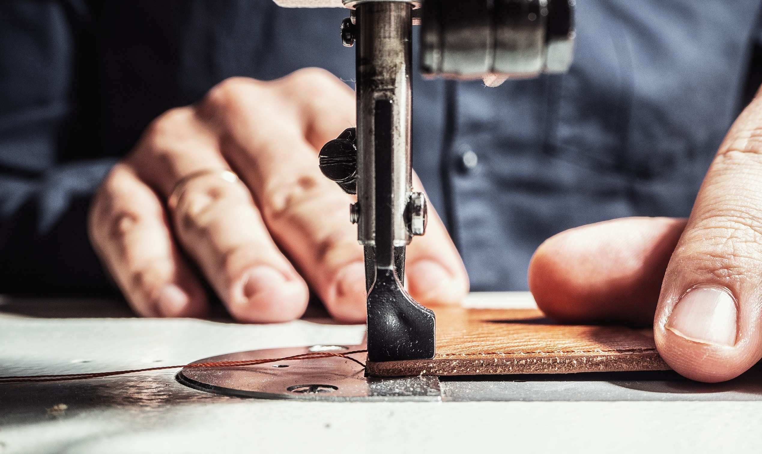



Social Justice
Who makes your T-shirt?

Slide 2
1. It takes 2,700 litres of water to grow the cotton needed for a t-shirt

Slide 3
1. It takes 2,700 litres of water to grow the cotton needed for a t-shirt
The water needed to produce a T-shirt would provide 900 days of water (WWF)
The annual footprints of household’s new and existing clothing are the same as the carbon emissions from driving a car 6,000 miles
70% of all water used globally is for agriculture

Slide 4
2. An estimated £140 million worth (350,000 tonnes) of used clothing goes to landfill every year in the UK

Slide 5
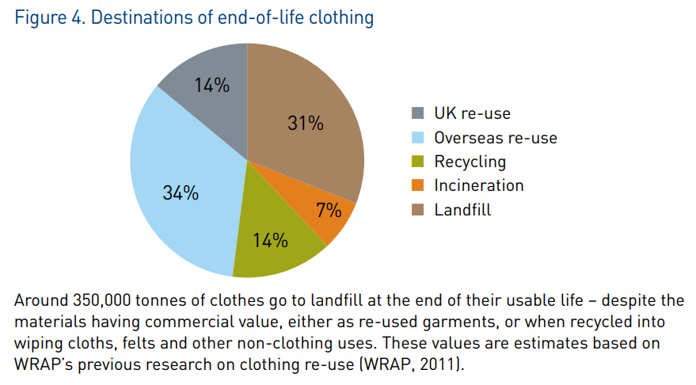
2. An estimated £140 million worth (350,000 tonnes) of used clothing goes to landfill every year in the UK

Slide 6
3. 20% of the water lost from the Aral Sea was caused by cotton consumption in the EU

Slide 7
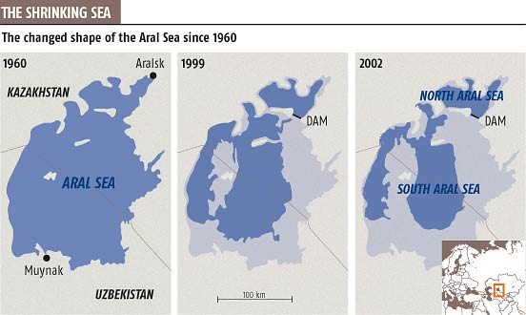
3. 20% of the water lost from the Aral Sea was caused by cotton consumption in the EU
Over 90% of the water footprint of UK clothing is overseas, often in countries which have water stress or scarcity.
Notes:
https://www.newscientist.com/article/dn3947-south-aral-sea-gone-in-15-years/

Slide 8
4. In Cambodia the fashion industry has caused approximately 60% of the countries water pollution

Slide 9
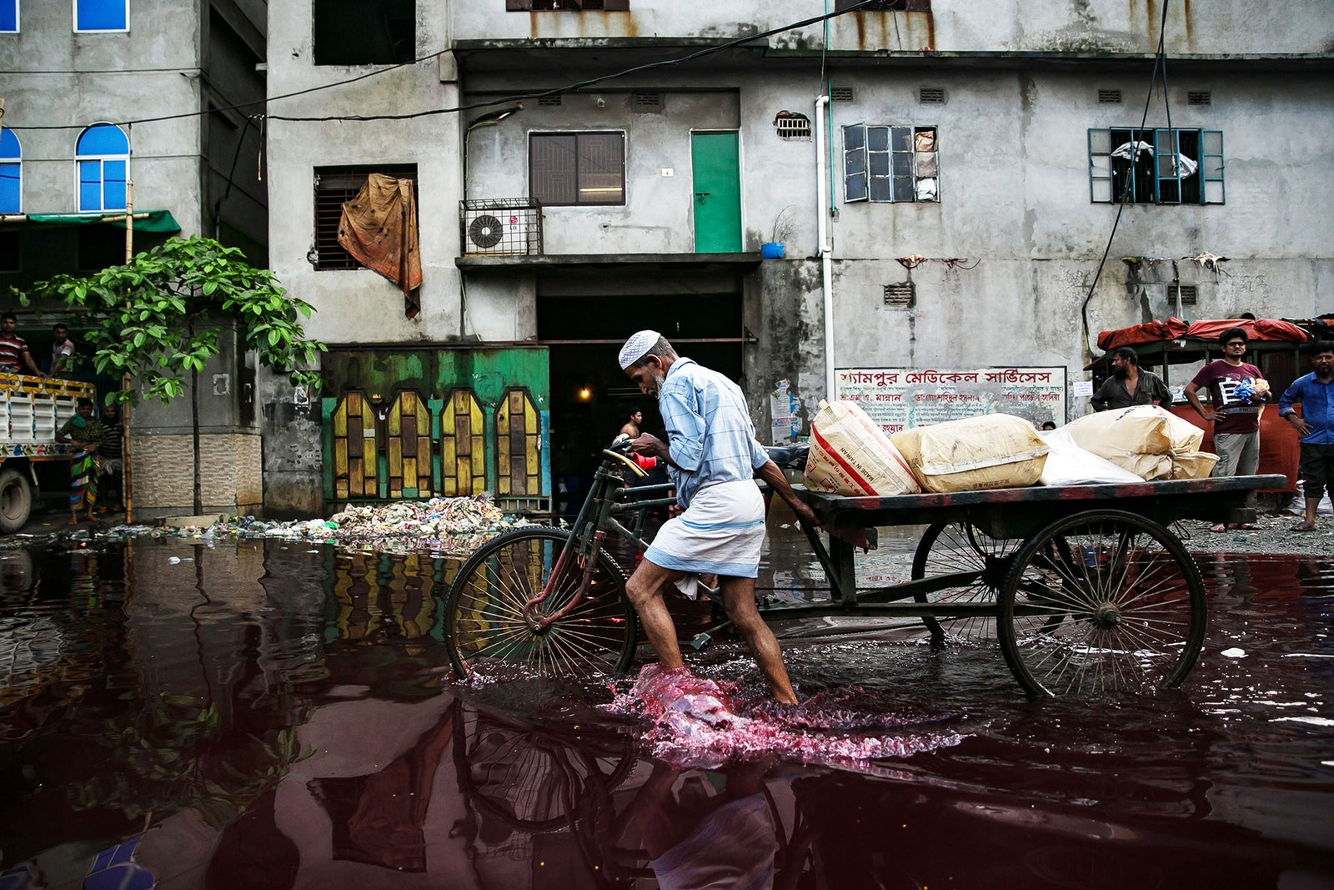
4. In Cambodia the fashion industry has caused approximately 60% of the countries water pollution
Globally ¾ of water needed for the dying process becomes an undrinkable toxic mix of dyes, salts, alkalis and heavy metals.
Some chemicals used to dye clothing in Asia are banned for use in the EU
Notes:
5 ways to fix fashion’s biggest pollution problem: dyes | Vogue India

Slide 10
5. People who make clothing abroad should be paid a local living wage

Slide 11
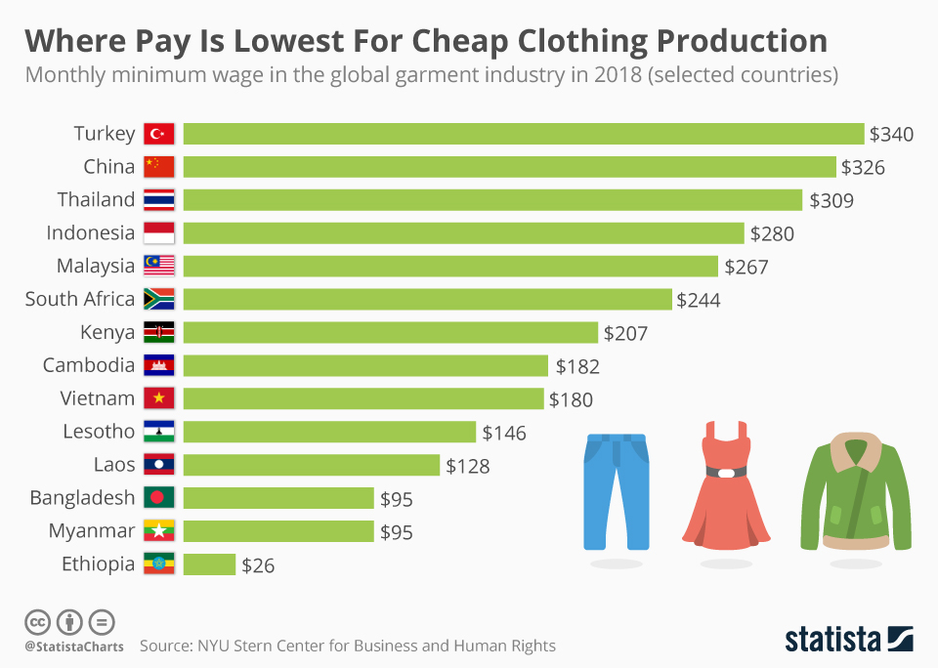
5. People who make clothing abroad should be paid a local living wage
Notes:
https://www.statista.com/chart/17903/monthly-minimum-wage-in-the-global-garment-industry/

Slide 12
6. People who stich the clothing being paid below local minimum wage only happens overseas

Slide 13
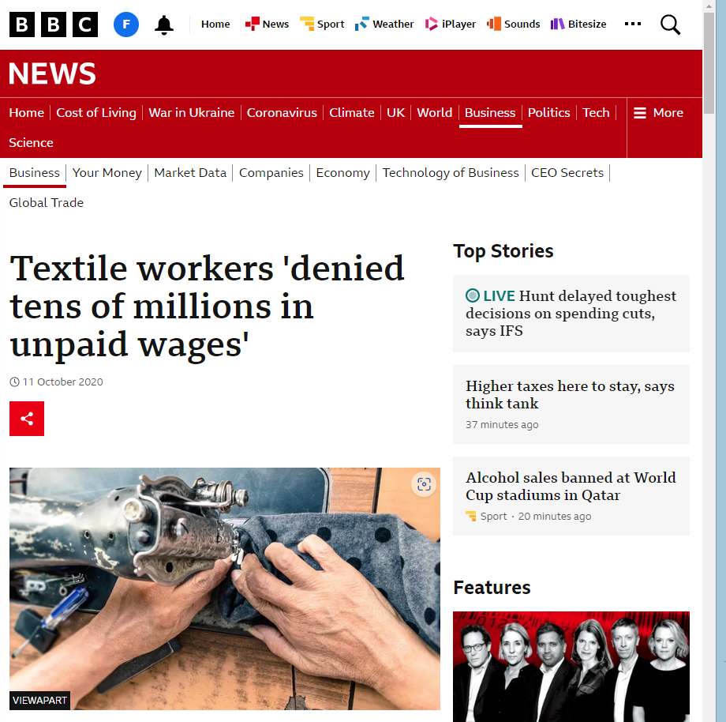

6. People who stich the clothing being paid below local minimum living wage only happens over seas
Notes:
Textile workers 'denied tens of millions in unpaid wages' - BBC News

Slide 14
7. It’s ok for big brands to say they don’t know what happens to workers and the environment in their supply chain

Slide 15
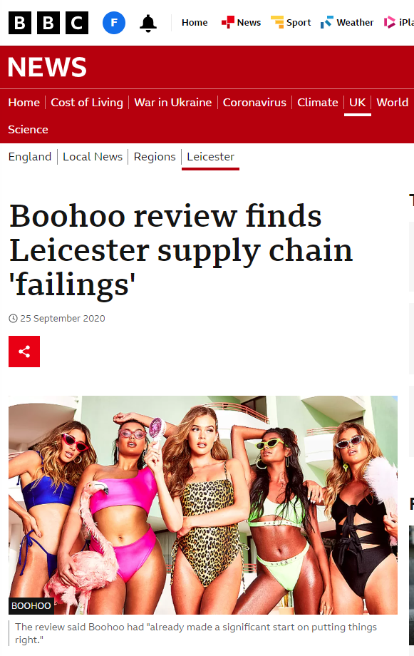
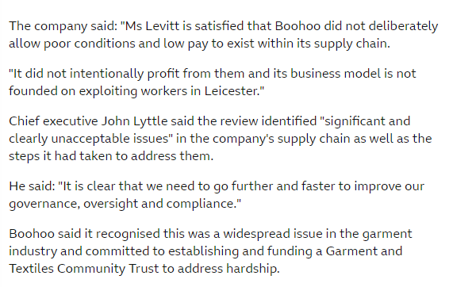
7. It’s ok for big brands to say they don’t know what happens to workers and the environment in their supply chain
40% of consumers think that there is too little environmental information available on the clothes they buy.
Clothing brands which demonstrate corporate responsibility and support their brands values by measuring and reducing environmental impact and have modern slavery policies in place can gain new customers and improved brand loyalty. E.g. Patagonia
Notes:
Boohoo review finds Leicester supply chain 'failings' - BBC News
Textiles | WRAP

Slide 16
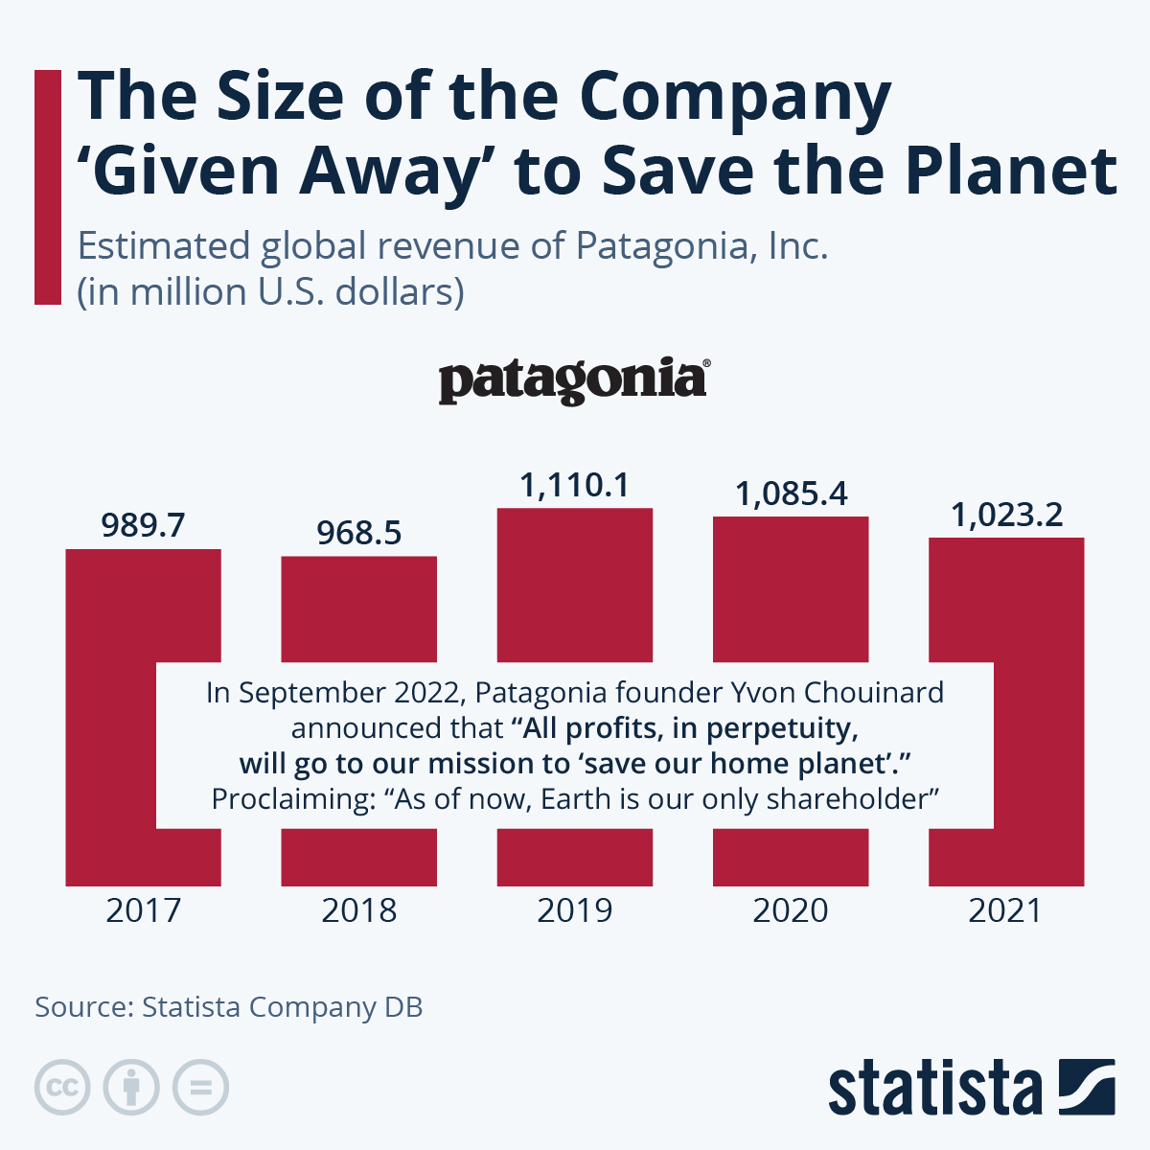
7. It’s ok for big brands to say they don’t know what happens to workers and the environment in their supply chain
Notes:
https://www.statista.com/chart/28257/patagonia-inc-revenue-company-db/

Slide 17
8. It’s ok for a plain adult T-shirt to cost £1.50 in the UK

Slide 18
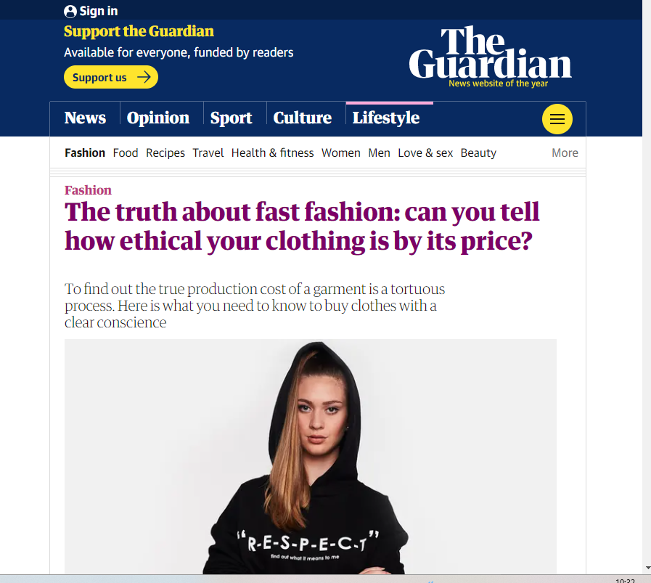
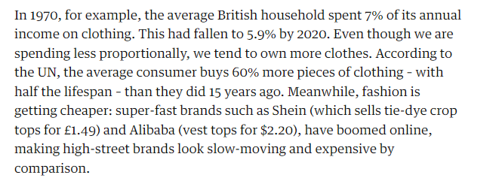
8. It’s ok for a plain adult T-shirt to cost £1.50 in the UK
Notes:
The truth about fast fashion: can you tell how ethical your clothing is by its price? | Fashion | The Guardian

Slide 19
9. It’s ok to have clothes that will never be worn

Slide 20
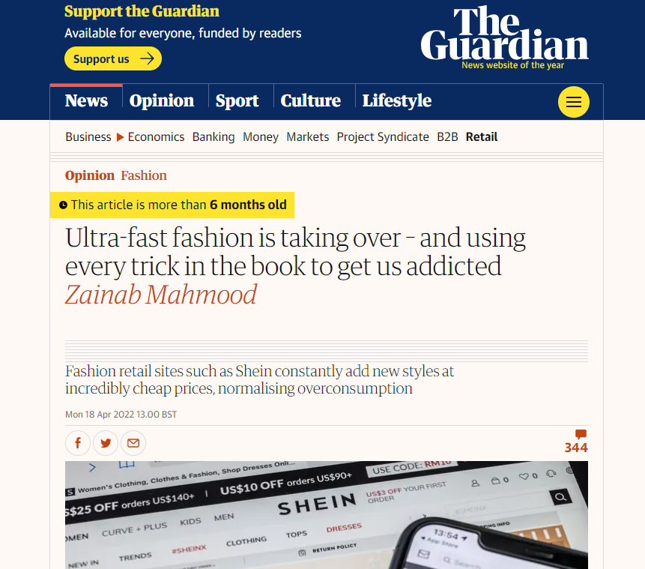
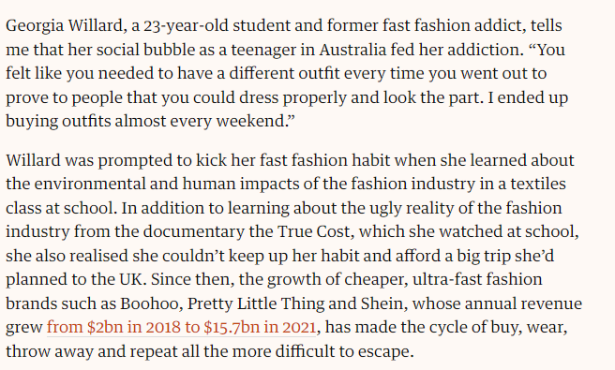
9. It’s ok to have clothes that will never be worn
Notes:
Ultra-fast fashion is taking over – and using every trick in the book to get us addicted | Zainab Mahmood | The Guardian

Slide 21
10. Child labour has a place in the fashion supply chain

Slide 22
10. Child labour has a place in the fashion supply chain
It is estimated that 170million children are engaged in child labour (not just fashion supply chains)
The Guardian reported that in some cases employers prefer children to carryout the low skilled tasks such as cotton picking because their hands are smaller so they do not damage the crop
Notes:
Real fashion consumer spending in Europe 2020, by country | Statista

Slide 23
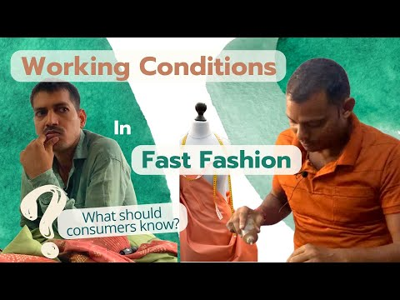
Notes:
Real fashion consumer spending in Europe 2020, by country | Statista

Slide 24
watch
https://www.bbc.co.uk/programmes/p013k58r
Notes:
Real fashion consumer spending in Europe 2020, by country | Statista

Slide 25
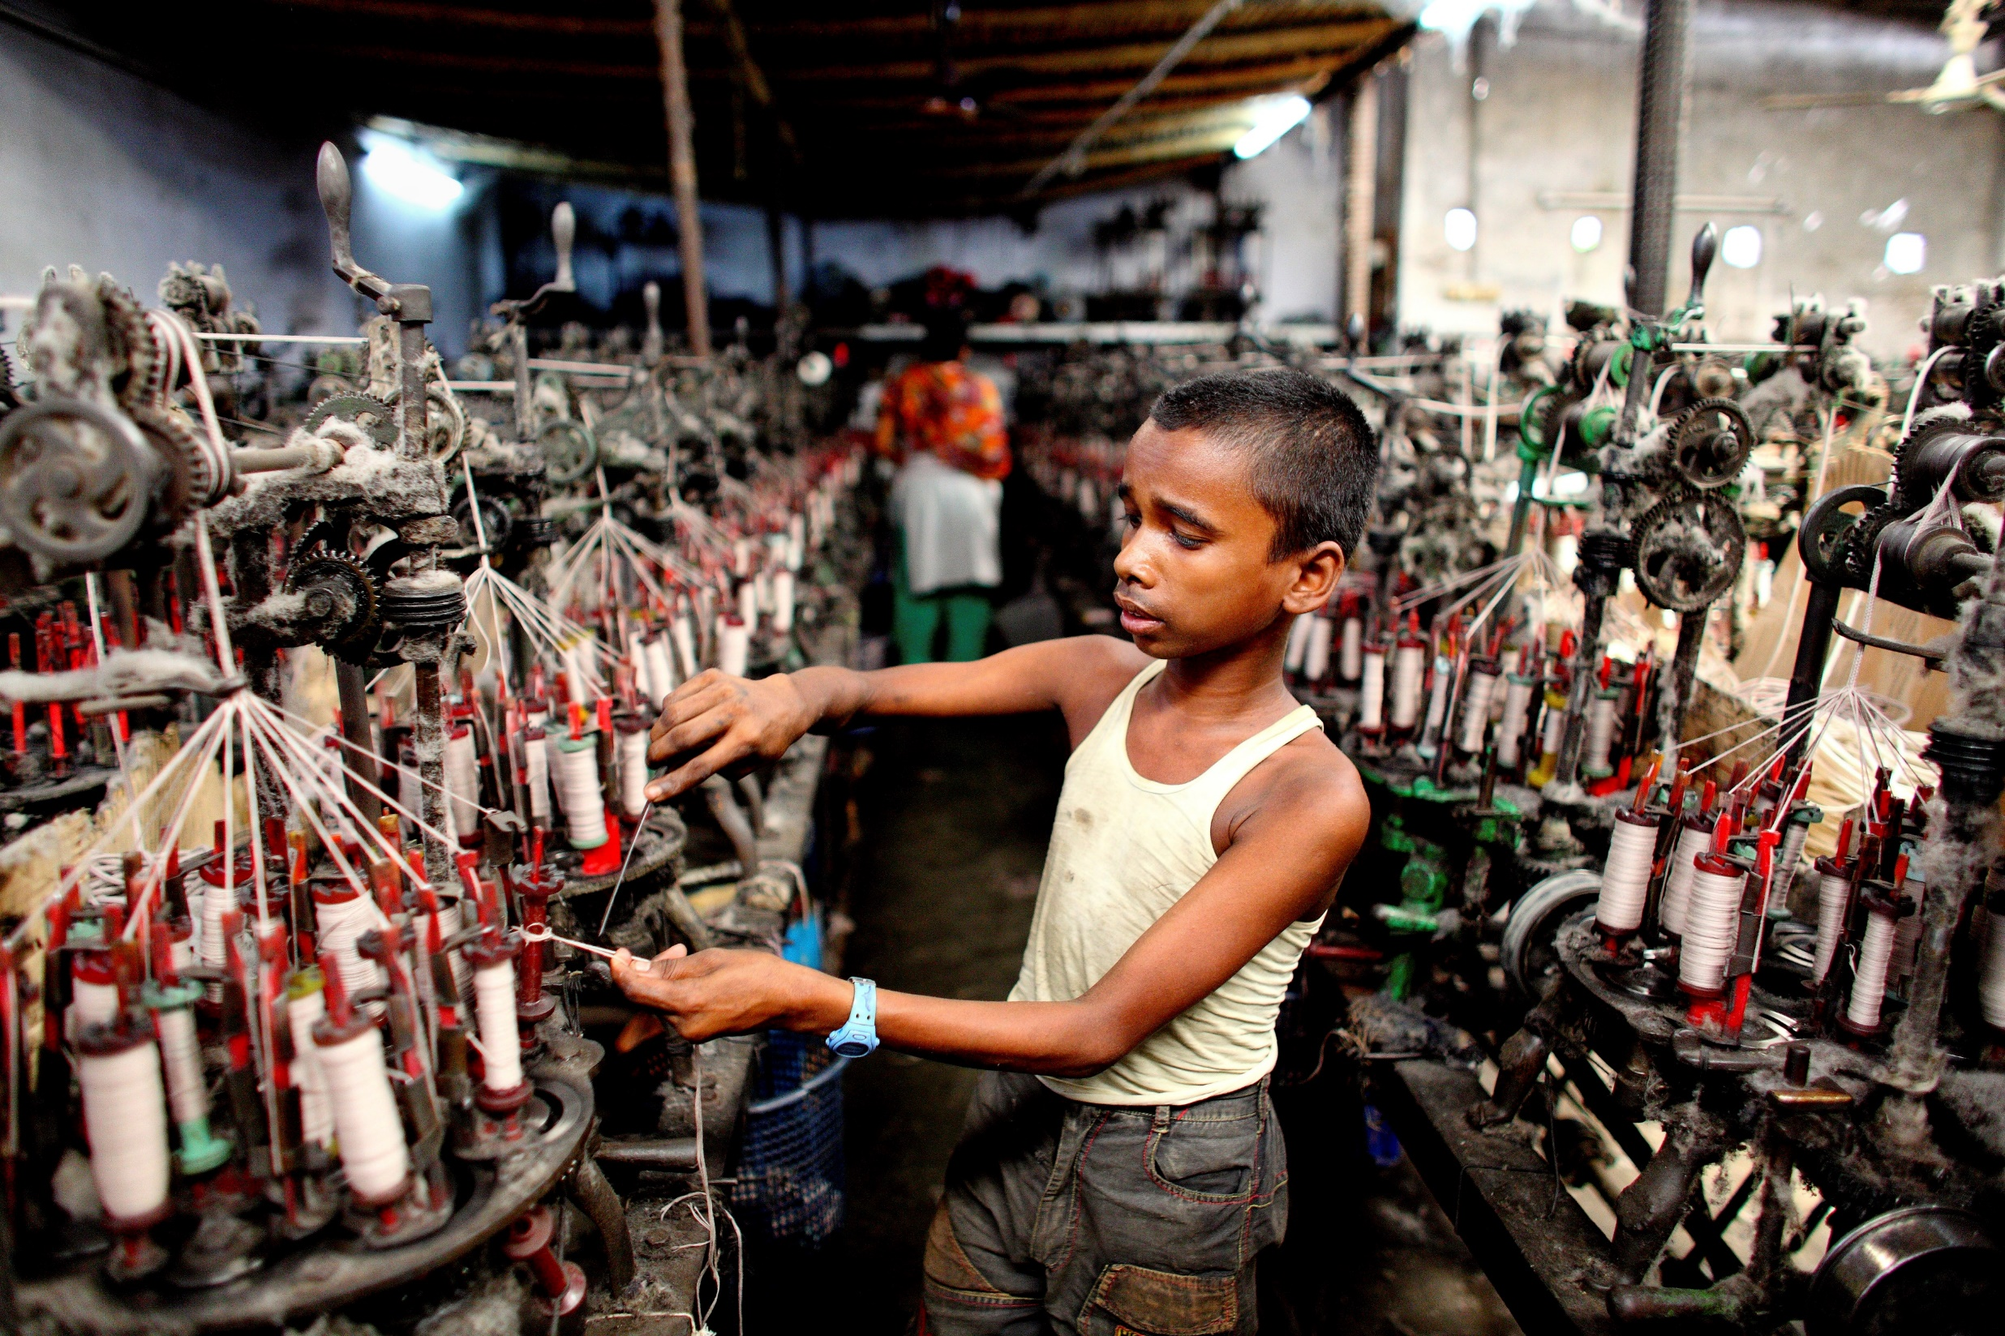
Notes:
Child labour in the fashion supply chain (theguardian.com)

Slide 26
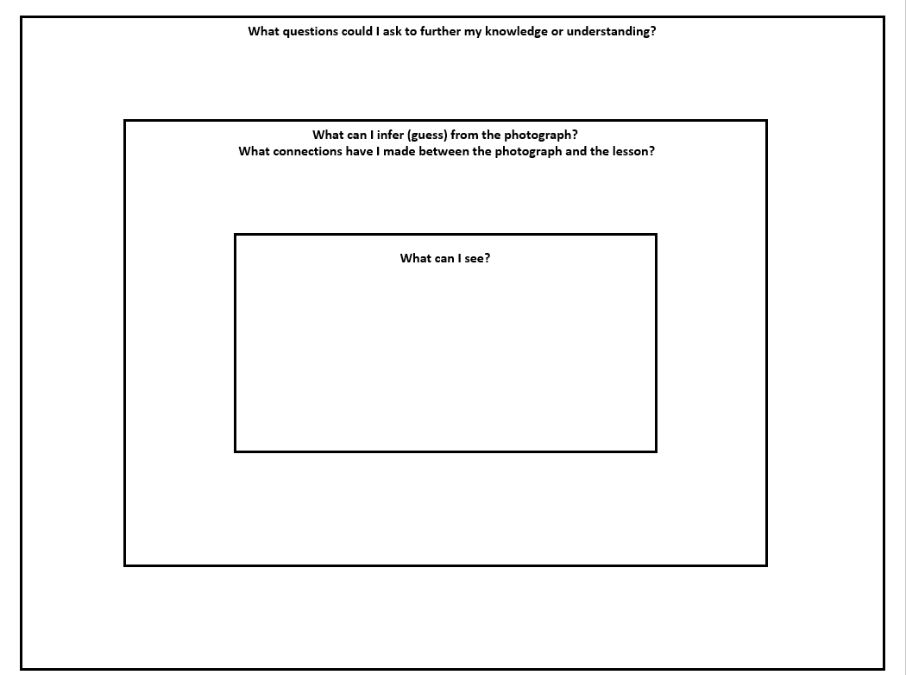

Slide 27

Environmental Charity CEO
Factory worker UK
Child
Government Minister
Stakeholders
Consumer
Cotton Grower
Factory Worker Overseas
River User
Fashion Brand
Factory Owner

Slide 28





33-35 Heol yr Eglwys Gadeiriol, Caerdydd, CF11 9HB | 33-35 Cathedral Rd, Cardiff, CF11 9HB
029 2025 6767 cadwchgymrundaclus.org | keepwalestidy.org comms@keepwalestidy.org
Cadwch Gymru’n Daclus yn gwmni wedi ei gyfyngu trwy warant. Rhif Cwmni: 4011164 Rhif Elusen: 1082058 Rhif TAW: 850 3958 13
Keep Wales Tidy is a Company Limited by Guarantee. Company Registration Number: 4011164 Charity Registration Number: 1082058 VAT Registration Number: 850 3958 13

