Slide 1
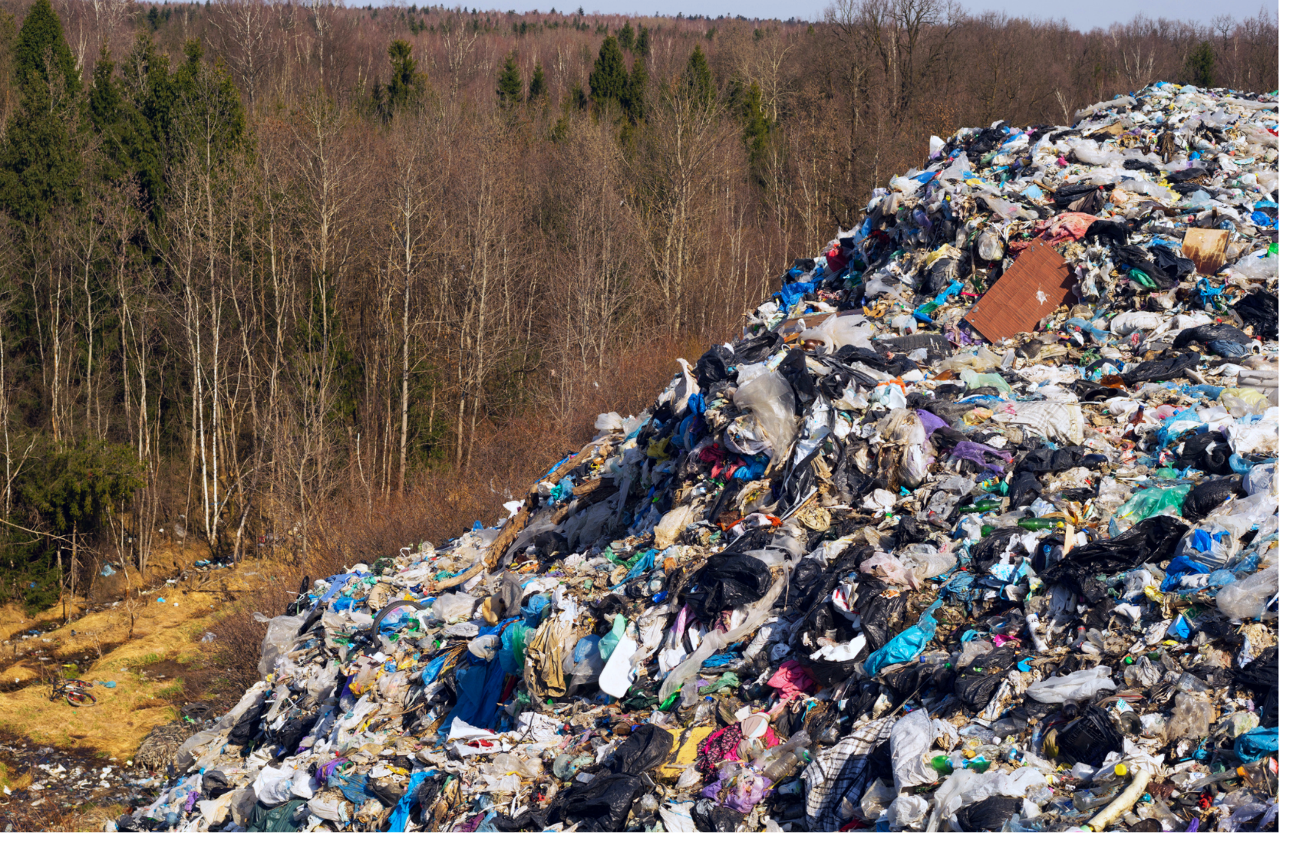




Understanding Fast Fashion

Slide 2







What is Fast Fashion?
Fast fashion is the mass production and sale of cheaply made clothing, often closely following the changing fashion trends.
The production of clothing has become faster and cheaper as a result of more advanced technology and the use of lower cost labour overseas. With lower prices, people have been buying clothes more frequently to keep up with the latest trends.

Slide 3

Notes:
Video - https://youtu.be/d55UGal_0BM

Slide 4
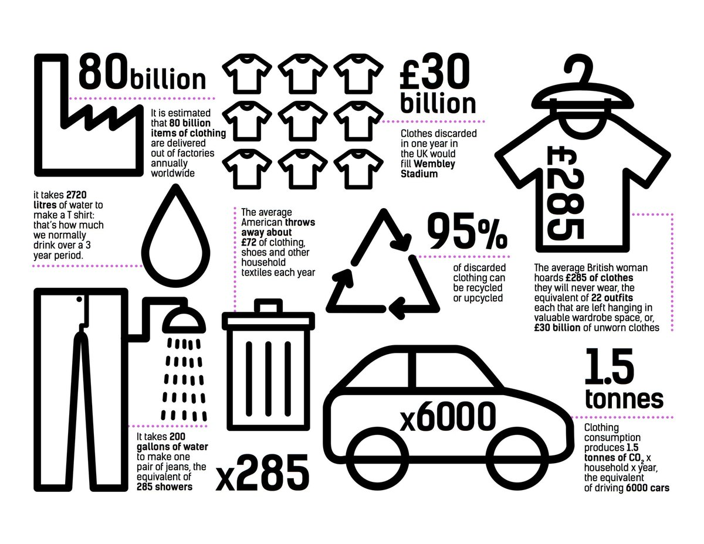
Notes:
Image from https://www.lylamod.com/

Slide 5
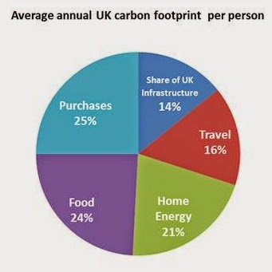
Individual Responsibility
Decisions we all make when choosing what we buy, wear and, dispose of have a huge impact on the environment.
In the UK, we all buy LOADS of ‘stuff’ and it is a huge part of our carbon footprint.

Slide 6
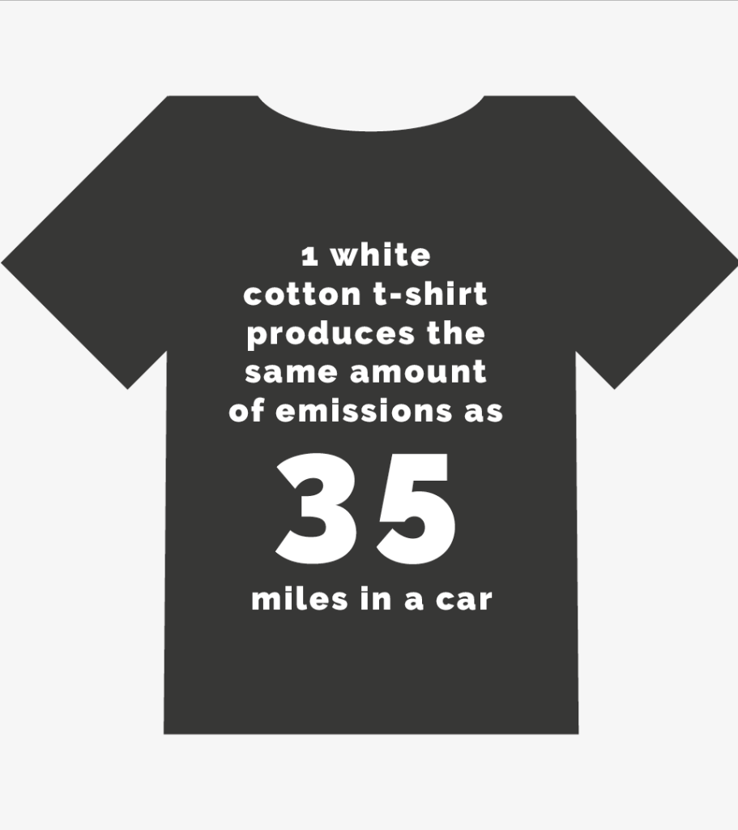
The T-Shirt Investigation
Individual Responsibility
Whilst carrying out your research, consider the following to feedback when finished:
How far do the clothes have to travel to get to the buyer?
Is information about the materials easy to find?
How sustainable/eco-friendly do you think each t-shirt is?
Is there any information about end of use/life care?
Any other interesting points you’d like to share?
How do you feel about buying new clothes having done this research? What changes could you make?
Consider what other options are there other than buying new clothes?
Notes:
Images from Eco Wardrobe - https://ecowardrobe.co.uk/sustainability/

Slide 7





33-35 Heol yr Eglwys Gadeiriol, Caerdydd, CF11 9HB | 33-35 Cathedral Rd, Cardiff, CF11 9HB
029 2025 6767 cadwchgymrundaclus.org | keepwalestidy.org comms@keepwalestidy.org
Cadwch Gymru’n Daclus yn gwmni wedi ei gyfyngu trwy warant. Rhif Cwmni: 4011164 Rhif Elusen: 1082058 Rhif TAW: 850 3958 13
Keep Wales Tidy is a Company Limited by Guarantee. Company Registration Number: 4011164 Charity Registration Number: 1082058 VAT Registration Number: 850 3958 13

